Slide 1
Addressing IPV in CHCs That Serve People Living with HIV: Universal Education on IPV to Promote Connection and Safety
Notes:
Anna open

Slide 2
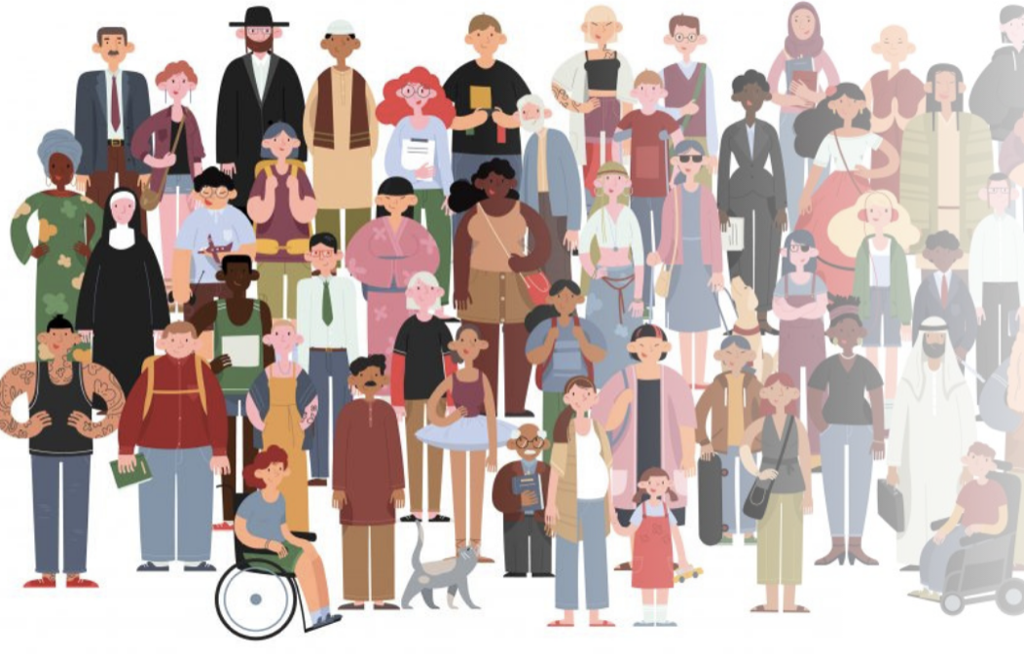
National Training and Technical Assistance Partner (NTTAP) funded by HRSA Bureau of Primary Care offering training and technical assistance on Intimate Partner Violence and Human Trafficking.
Promote partnerships between community health centers, anti-violence programs, and community based organizations.
Support staff in addressing and preventing violence in the lives of their patients.
Offer tools and resources to build capacity around trauma informed care and improve systems response
Notes:
Anna

Slide 3
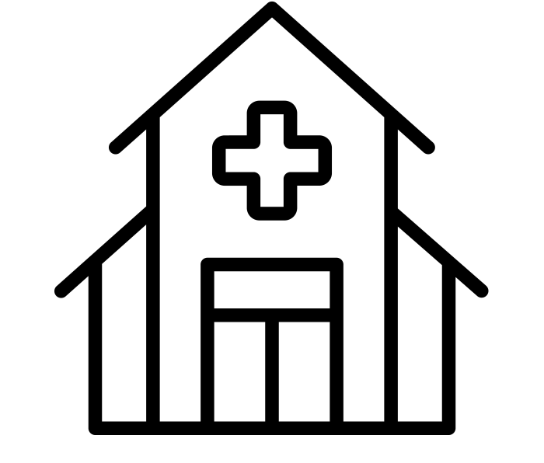
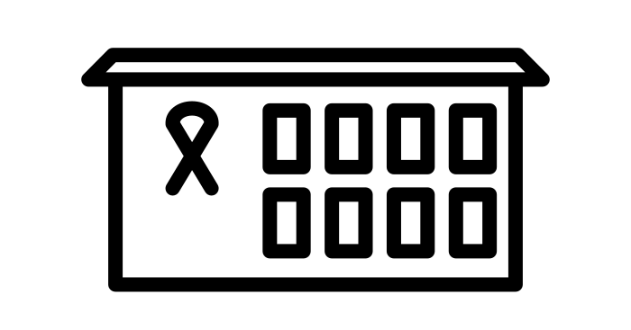
Who is a part of this learning collaborative?
anti-violence organizations
community health centers
public health departments
other Ryan White funded programs
Notes:
Domestic violence and sexual assault programs have vast experiences working with survivors of violence and assist them to identify ways to increase personal safety while assessing the risks.
Advocates connect patients to additional services like:
Crisis safety planning (usually 24/hr hotline)
Housing (emergency and transitional)
Legal advocacy for IPV/HT, family court, immigration, labor
Support groups/counseling
Children’s services
Employment support
Community health centers are community-based and patient-directed organizations that deliver no-cost/ low-cost comprehensive primary health care.
They often include:
pharmacy
mental health services
substance abuse programs
oral health services
Located in medically underserved areas and for medically underserved populations.
Notes to Trainer: Read the slide and supplement with additional info from the list below as needed:
Health Center Program Fundamentals:
Supportive services such as health education, translation, and transportation that promote access to health care.
Operate under the direction of patient-majority governing boards of autonomous community-based organizations. These include public and private non-profit organizations and tribal and faith-based organizations.
Develop systems of patient-centered and integrated care that respond to the unique needs of diverse medically underserved areas and populations.
Additional information:
Learn more about HRSA-funded community health centers: https://bphc.hrsa.gov/about/what-is-a-health-center/index.html

Slide 4
Community Health Centers
https://bphc.hrsa.gov/about/healthcenterprogram/index.html
Notes:
Kim (2 min)
Read the first stat (30M ppl, 1 in 11) view a few key stats on slide
Note to trainer: Please read. “To give context for how many people are served and how long they have been served and the range of services provided …HRSA’s investments have advanced the nation’s health by ensuring more patients and communities each year have access to high quality, comprehensive primary care. Today, HRSA funds nearly 1,400 health centers operating almost 13,000 service delivery sites in every U.S. state, U.S. territory, and the District of Columbia. In 2019, there were more than 252,000 full-time health center providers and staff serving nearly 30 million patients. Health centers have more than tripled the number of patients served since 2000.”
Because health centers provide high quality primary care services across the country, the health center network is also called upon to support public health priorities such as the opioid crisis, the White House Ending the HIV Epidemic, and the response to COVID-19.”

Slide 5
Learning Objectives:
List key tools and technical assistance from Health Partners on IPV + Exploitation
Connect with other community health center practitioners who are working to address the intersections HIV and IPV
Understand the health impact of IPV on people living with HIV

Slide 6
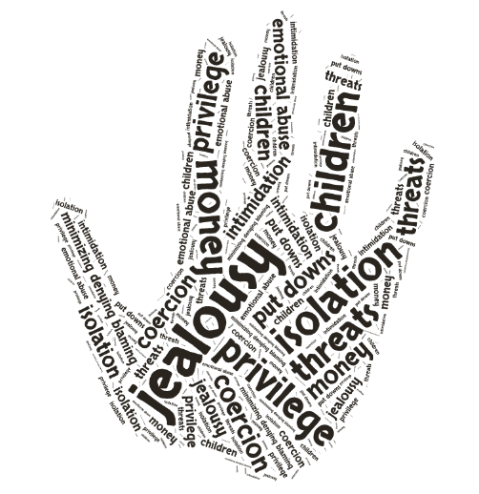
Intimate Partner Violence
A pattern of behavior that one or more people use to gain power and control over another person in an intimate relationship.
Image: wordle
Notes:
The focus of this curriculum’s content, strategies and data is domestic violence/intimate partner violence (DV/IPV). Read this definition of intimate partner violence and ask:
What stands out to participants? What pieces of this definition are important?
Why are those elements important for us to hold as we as care providers conceptualize or clients’ experiences of violence?
Is there any thing missing from this definition?
Power and control: Intimate partner or domestic violence comes down to power and control. People use many different methods of controlling their partners, including but not limited to physical violence. (More on this on the next slide).
Pattern: It is important that we think of intimate partner violence as a pattern. It is not a one-time incidence of violence, but rather harm and controlling behaviors that the partner is engaging and builds over-time.

Slide 7
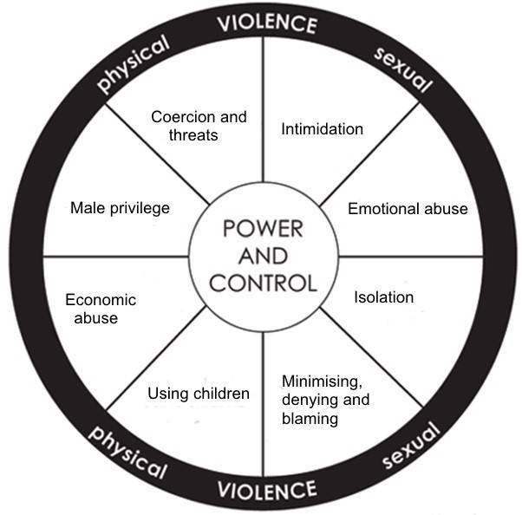

Slide 8
IPV is common
At least 1 in 4 women and 1 in 9 men in the U.S. have experienced rape, physical violence, and/or stalking by an intimate partner in their lifetime. CDC NISVS, 2011
Because of oppression, rates are higher for marginalized and historically exploited people:
LGBTQI CDC NISVS, 2011; The Task Force, 2011
Black and Indigenous people
Migrant
People living with HIV
CDC NISVS, 2011; The Task Force, 2011
Notes:
Read through the data on the slide. Underscore that experiences of IPV are common. (The data reflect that IPV and sexual violence is more commonly experienced by some queer and trans folks. Intersections of vulnerability and oppression will be addressed in the coming slides.)
Description of data and additional data:
According to data from the National Violence Against Women Survey approximately:
11% of women who lived with a woman as part of a couple reported being raped, physically assaulted, and/or stalked by a female cohabitant compared to 30.4% of the women who had married or lived with a man as part of a couple.
15% percent of men who lived with a man as a couple reported being raped, physically assaulted, and/or stalked by a male cohabitant compared to 7.7% of men who had married or lived with a woman as a couple.
Men and women who had lived with a same-sex partner as part of a couple disclosed significantly higher levels of IPV than opposite-sex cohabitants.
However, comparisons of these rates by the gender of the couple and gender of the perpetrator indicate that same-sex cohabiting women were three times more likely to report being victimized by a former male partner than by a female partner in their lifetime and same-sex cohabiting men were more likely to report being victimized by a male partner than a female partner in their lifetime. These findings suggest that IPV is perpetrated primarily by men, whether against male or female partners.
Breiding MJ, Smith SG, Basile KC, Walters ML, Chen J, Merrick MT. Prevalence and Characteristics of Sexual Violence, Stalking, and Intimate Partner Violence Victimization—National Intimate Partner and Sexual Violence Survey, United States, 2011. MMWR 2014; 63(SS-8): 1-18.
Landers S, Gilsanz P. The health of lesbian, gay, bisexual, and transgender (LGBT) persons in Massachusetts. Massachusetts Department of Public Health; 2009.
Braun V, Schmidt J, Gavey N, Fenaughty J. (2009). Sexual Coercion Among Gay and Bisexual Men in Aoteraroa/New Zealand. Journal of Homosexuality, 56:336-360.
Houston E, McKirnan DJ. (2007). Intimate Partner Abuse Among Gay and Bisexual Men: Risk Correlates and Health Outcomes. Journal of Urban Health, Bulletin of the New York Academy of Medicine., 84(5):681-690.
Tjaden P and Thoennes N. (2000). Full report of the prevalence, incidence, and consequences of violence against women: finding from the national violence against women survey. U.S. Department of Justice, National Institute of Justice, and U.S. Department of Health and Human Services, Centers for Disease Control. NCJ 183781.
Grant JM, Mottet L, Tanis J, Harrison J, Herman J, Keisling M. (2011) Injustice at Every Turn: A Report of the National Transgender Discrimination Survey. Washington: National Center for Transgender Equality and National Gay and Lesbian Task Force.http://www.thetaskforce.org/static_html/downloads/reports/reports/ntds_full.pdf
FORGE “Transgender Rates of Violence” October 2012 http://forge-forward.org/wp-content/docs/FAQ-10-2012-rates-of-violence.pdf

Slide 9
IPV is complex
Violence is not always the priority
Cycles through “good times” and “bad times”
Breaking down the victim/perpetrator binary
People use “abusive behaviors” to survive
Everyone needs support
Image: Prexels

Slide 10
Interpersonal/Intimate Gendered Violence Across the Lifespan
Intimate partner violence/relationship abuse
child sexual abuse
sexual harassment
rape and sexual violence
elder abuse
human trafficking + labor exploitation
community violence
white supremacist extremist violence
gender policing/enforcement
homo-, bi-, and transphobia
sexism and Misogynoir
HIV stigma
Community(-Level) Violence
Interpersonal/Intimate Violence
API GBV Lifetime Spiral of Gender Violence; (Galtung, 1969) (Lee, 2019)(Bailey, 2021)
Notes:
I think typically what may come to mind when we think of violence, is one person physically harming another person, but if we are using that WHO definition of violence, we have to be including forms of violence across levels of society – or across levels of the socio-ecologic model. So in just thinking about the context of the US today.
We have violence that happens in intimate or family relationships, or in intimate spaces
Violence that happens between members of communities or in community spaces–
Galtung J. "Violence, Peace, and Peace Research" Journal of Peace Research, Vol. 6, No. 3. 1969.
Lee B. Violence: An Interdisciplinary Approach to Causes, Consequences, and Cures. Wiley-Blackwell. pp. 123–142. 2019.

Slide 11
Institutional and Structural Gendered Violence
Structural Violence
criminalization of sex work, drug use, HIV, houselessness
forced sterilization/controlled reproduction
police/prison-perpetrated sexual violence and brutality
gentrification and racist housing policy
immigrant detention + family separation
labor exploitation, wage theft, poverty wages
punitive family control systems
lack of free universal childcare
investment in policing, prisons, and surveillance as a solution to social problems
employer-based healthcare
disinvestment in public health, public education
Institutional Violence
Community(-Level) Violence
Interpersonal/Intimate Violence
http://www.futureswithoutviolence.org/health/racism/ (Galtung, 1969) (Lee, 2019)
Notes:
Violence that is perpetrated by instructions, or tools of institutions to gain and maintain power and control, violence that is backed up by institutional power – which is not discrete from
Structural violence in US we can think of as policies and other ways that our governments and economic system codify and uphold white supremacy, class hierarchy, gender binary, patriarchy, nativism, imperialism – and keep people from having their basic human needs and rights met.
Violence – as a means of maintaining power and control – is used across levels of our society and that structural and institutional violence not only create the conditions for violence that happens in communities and families, but also use intimate forms of violence to exert power. I am including this representation as context as we think about public health approaches to violence so that we are aware of the intersecting forms of violence our patients are surviving, and the structural and institutional forms of violence we need address as a means of preventing intimate violence. I also ask us to pause and notice what forms of violence in this representation are considered crimes or are criminalized, and those that are not. I say this so that we can think about measuring violence and its impact by the as harm that it causes, and not so much whether or not it breaks current law.
Galtung J. "Violence, Peace, and Peace Research" Journal of Peace Research, Vol. 6, No. 3. 1969.
Lee B. Violence: An Interdisciplinary Approach to Causes, Consequences, and Cures. Wiley-Blackwell. pp. 123–142. 2019.

Slide 12
HIV Stigma Increases Vulnerability to IPV
A study done in a HIV primary care clinic found that:
(73%) of the sample reported lifetime IPV and 20% reported current abuse.
More than one fourth (29%) of those abused felt the abuse was related to their HIV status.
(Ramachandran, 2010)
Notes:
Ramachandran S, Yonas MA, Silvestre AJ, Burke JG. Intimate partner violence among HIV-positive persons in an urban clinic. AIDS Care. 2010;22(12):1536-43. https://www.ncbi.nlm.nih.gov/pmc/articles/PMC3005966/
This pilot study, conducted at an urban clinic, explores the IPV experiences of HIV positive persons involved in both heterosexual and homosexual relationships. Fifty-six HIV positive individuals were interviewed to assess for verbal, physical, and sexual IPV, and for HIV-related abuse and attitudes regarding routine IPV screening. Approximately three quarters (73%) of the sample reported lifetime IPV and 20% reported current abuse. Physical IPV (85%) was cited the most by abused participants. IPV rates were highest among African Americans and men who have sex with men (MSM). More than one fourth (29%) of those abused felt the abuse was related to their HIV status. A majority of participants favored IPV screening by providers, but felt it might increase risk of IPV. IPV and its association to HIV are significant issues among this sample. Findings support the need for developing new programs that address these epidemics simultaneously.

Slide 13
IPV keep survivors from healthcare
A systematic review found that IPV survivors were significantly less likely to be able to:
Seek testing
Act on linkage to care
Stay engaged with care
Initiate and be able to adhere to ART
Achieve undetectable viral load
Leddy, 2019
Notes:
Read slide.
Leddy AM, Weiss E, Yam E, Pulerwitz J. Gender-based violence and engagement in biomedical HIV prevention, care and treatment: a scoping review. BMC Public Health. 2019;19(1):897. Published 2019 Jul 8. doi:10.1186/s12889-019-7192-4
Schafer KR, Brant J, Gupta S, et al. Intimate partner violence: a predictor of worse HIV outcomes and engagement in care. AIDS Patient Care STDS. 2012;26(6):356-65.
Hatcher AM, Smout EM, Turan JM, Christofides N, Stöckl H. Intimate partner violence and engagement in HIV care and treatment among women: a systematic review and meta-analysis. AIDS. 2015 Oct 23;29(16):2183-94.
Schafer KR, Brant J, Gupta S, et al. Intimate partner violence: a predictor of worse HIV outcomes and engagement in care. AIDS Patient Care STDS. Jun 2012;26(6):356-365.
Cohen MH, Cook JA, Grey D, et al. Medically eligible women who do not use HAART: the importance of abuse, drug use, and race. Am J Public Health. Jul 2004;94(7):1147-1151.
Mugavero MJ, Raper JL, Reif S, et al. Overload: impact of incident stressful events on antiretroviral medication adherence and virologic failure in a longitudinal, multisite human immunodeficiency virus cohort study. Psychosom Med. Nov 2009;71(9):920-926.
Mugavero M, Ostermann J, Whetten K, et al. Barriers to antiretroviral adherence: the importance of depression, abuse, and other traumatic events. AIDS Patient Care STDS. Jun 2006;20(6):418- 428.
Leserman J. Role of depression, stress, and trauma in HIV disease progression. Psychosom Med. Jun 2008;70(5):539-545.
Another study:
In this study by McCloskey et al. (2007), 2027 women outpatients across five different medical departments housed in 8 hospital and clinic sites completed a written survey. Fifty-nine percent of participants were white, 38% were married, and 22.6% were born outside of the U.S. Nearly 14% of the women disclosed recent IPV and 37% confirmed ever being in a violent relationship.
17% of women who had been physically abused by an intimate partner in the past year reported that their partner did not allow them to access health care or interfered with their health care compared to 2% of non-abused women.
Women with interfering partners were significantly more likely to report having poorer health (OR=1.8)
McCloskey LA, Williams CM, Lichter E, Gerber M, Ganz ML, Sege R. Abused women disclose partner interference with health care: an unrecognized form of battering. Journal of General Internal Medicine. 2007;22:1067–1072.

Slide 14
What your settings are already doing to address IPV
Screening all patients and those that exhibit red flags
Screening for SDOH
Offering referrals to anti-violence agencies to patients that disclose IPV or exhibit red flags
Training for clinical staff on IPV related issues
Partnering with local anti-violence programs
Regular partnership meetings
Cross-referral procedures with partners
Cross trainings for staff
IPV protocols
Are we missing anything?
Notes:
You are already doing so many things to reach survivors. Today we will offer a survivor-centered approach that will help you be more effective in improving the health and safety outcomes for survivors

Slide 15
Share in chat
Why don't people choose to disclose experiences of violence or trauma?
How can a screen and refer method further entrench a power differential between health care providers and patients?

Slide 16
What is the end goal of screening tools for violence and trauma?
Data? (History of ACE questionnaire)
Getting a disclosure?
Knowing about what has happened to the person we are working with so we can anticipate their needs?
Getting the person connected to services?

Slide 17
The Heart of Being Healing-Centered
Challenging the limits of disclosure-driven practice
Do we need to know what has happened to our clients/patients?
How are we making sure that people who will not disclose still get access to services?
If we are using “red-flags” to signal inquiry, how do we make sure the people with no red flags are getting access to services?
Notes:
Do we need to know what has happened to our clients/patients in order to make sure they have access to supportive services?
If we are using a screening tool, how are we making sure that people who will not disclose still get access to services?
If we are using “red-flags” to signal inquiry, how do we make sure the people with no red flags are getting access to services? (people who have been surviving)

Slide 18
Rethinking Screening
How does a screening-based approach contribute to health inequities?
Low disclosure rates
Not survivor centered
Resources offered only based on a patient’s disclosure
Missed opportunity for prevention education
What if disclosure/identification is no longer the goal?
(Jack, 2016)
Notes:
Notes to Trainers: Read the slide aloud, and share what the research has shown for disclosure-driven screening practices. In this study by McCloskey et al. (2006), 132 women outpatients who disclosed domestic violence in the preceding year were recruited from multiple hospital departments and community agencies. Abused women who talked with their health care providers about the abuse were more likely to use an intervention and exit the abusive relationship. Women who were no longer with their abuser reported better physical health than women who stayed.
McCloskey LA, Lichter E, Williams C, Gerber M, Wittenberg E, Ganz M. Assessing Intimate Partner Violence in Health Care Settings Leads to Women’s Receipt of Interventions and Improved Health. Public Health Reporter. 2006;121(4):435-444.
Susan M. Jack, Marilyn Ford-Gilboe, Danielle Davidov and Harriet L. MacMillan, Identification and Assessment of Intimate Partner Violence in Nurse Home Visitation, Journal of Clinical Nursing Vol. 25 Issue 13-14: 2015.

Slide 19
Shifting Away from Screening…
“No one is hurting you at home, right?” (Partner seated next to client as this is asked — consider how that felt to the patient?)
“Within the last year has he ever hurt you or hit you?” (Nurse with back to you at her computer screen)
“I’m really sorry I have to ask you these questions, it’s a requirement of our clinic.” (Screening tool in hand -- What was the staff communicating to the patient?)
Notes:
Kim
Notes to Trainer: Read the slide aloud, noting that these are examples of screening practices for IPV. The goal is get the audience to understand why these were not effective practices. Ask questions such as: "Do you think the health care provider realized they were asking in a way that told the client to say no?” Suggest that it may be a lack of trauma informed organizational practice at work here—maybe the provider couldn’t handle or didn’t feel prepared for the yes?
Remind the audience:
Do no harm: safety considerations
When, where, and how you ask matters
Screening for IPV should not be a checklist
If done poorly it can be harmful
From old slide: Here is an example of an evidence- based question used with pregnant women, “Have you ever been hit, kicked, slapped, hurt, choked by a current or former partner?”
From old slide: Question: How many positive disclosures of IPV does your health center get per year?
(please type your best guess in chat box)
Note: reflect on clinic screening practice, not just own individual screening

Slide 20
Universal Education
Provides an opportunity for clients to make the connection between violence, health problems, and risk behaviors.
* If you currently have IPV/HT screening as part of your health center requirements: we strongly recommend first doing universal education.
Notes:
Rebecca, 1 minute and when finished reading slide turn to Anna for a stretch
Notes to Trainer: Read aloud “Our contribution to helping support health equity is universal education. Universal education approach for IPV/HT offers support to those:
who have never experienced IPV/HT
who are currently experiencing IPV/HT
who may have a lifetime history of IPV/HT.”
Say “we’re going to pause for a minute here reaching this introduction to universal education…and Anna’s going to lead us all through a stretch to wake up our minds and bodies a little before we move into our CUES approach. Anna…”
Additional Points:
May share that it’s an opportunity for providers or health staff to share their power with patients such that they will no longer have to first receive something from a patient (such as a disclosure about violence/abuse) in order to give something over (which is resources that can lead to safety and health improvements). Recognize that this power shift changes how providers previously were limited in giving information/referrals and to the patients who said ‘yes’ (disclosure). Universal education is an opportunity to better share/exchange power with patients and for them to know that they can disclose, or not...and still receive lifesaving safety and health information and referrals.

Slide 21
Confidentiality
Universal Education
Empowerment
Support

Slide 27
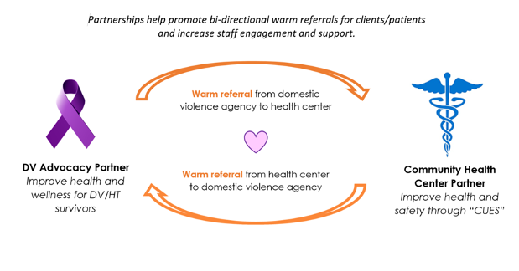

Slide 28
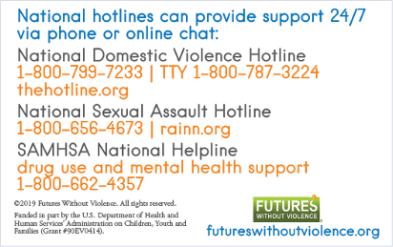
Everyone gets support
On the back of every safety card, there are hotlines that clients can use or share with someone who needs help.

Slide 29
Small Group Case Work
Jackson is a 23-year-old man living with HIV. You shared the universal education on IPV with him at his last visit and he is back to address some issues with his medication.
Two Scenarios
Jackson discloses experiencing coercion or control in his intimate relationship.
Jackson gives indications of a controlling partner, but he brushes it off when you bring it up or try to probe a little further.
Discuss
What would you want to do in these situations?
How do you establish a trusting relationship?
What is the goal of your support?
How might you intervene, if at all?

Slide 30
A word about Safety Planning
Safety planning is not:
Safety planning is:
Problem solving or rescuing
Clinical treatment
A checklist
Getting survivors to “leave”
Just about decreasing violence
Recommending what we think is best
Happening before you
Increasing survivor choice, power, options, safety, wellness, connections, knowledge
Decreasing survivor isolation + barriers
An ongoing process + partnership
Not something one has to do alone
Notes:
Happening before you/after you
Controlled by survivors/survivor self-determination
An ongoing process, conversation, partnership
Not something you have to do alone
Increasing survivor choice, power, options, safety, wellness, connections
Decreasing survivor isolation, barriers, injustice

Slide 31
Health Promotion + Harm Reduction = Safety Planning
How can health care staff…
Increase choice, power, options, safety, wellness, connections, knowledge
Decrease isolation + barriers
Around the survivor’s health and wellness?

Slide 32
Comprehensive response
Partnerships
Adopt CUES
Staff training
Protocol and policies
Trauma informed workplaces
Environmental changes

Slide 33
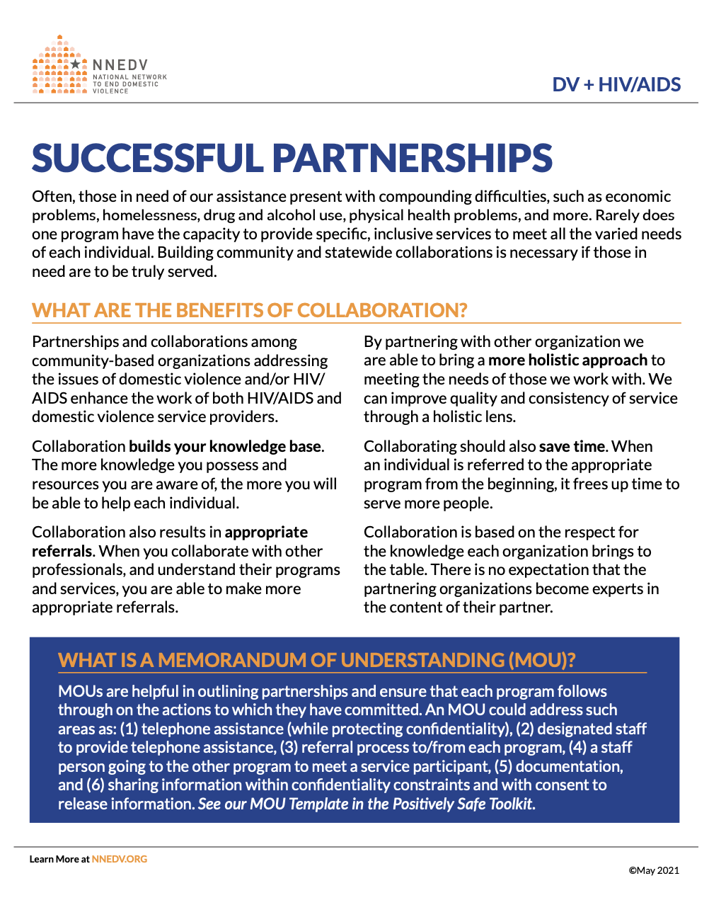
Partnerships with DV/community advocates
Partnering with advocates can make healthcare’s job easier and survivors safer!
Connect with your local DV agency
Host cross-trainings with the DV agency to promote shared knowledge between staff
Develop a survivor referral procedure between health setting and advocates
Develop an MOU
Notes:
Read slide.

Slide 34
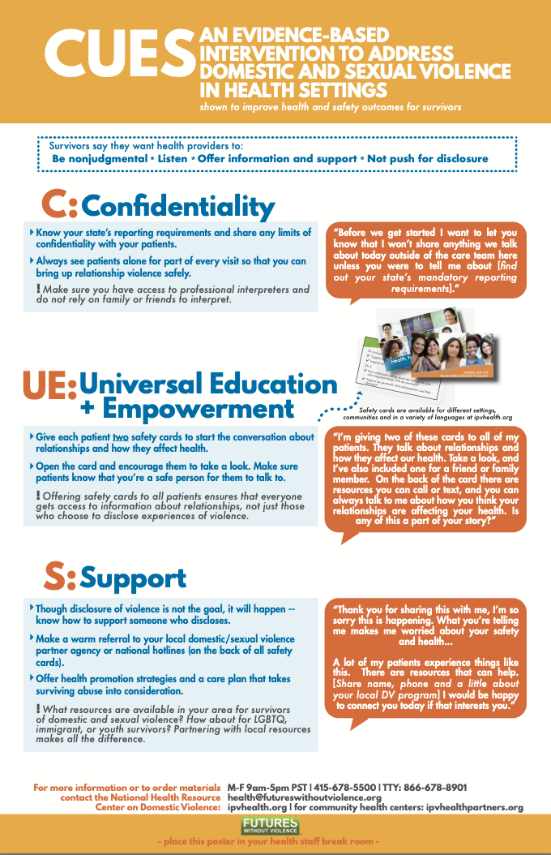
Adopting CUES universal education
Practice and develop scripting
Think through how different roles would use it
Try it out and debrief with colleagues
Map out who would be best to provide UE in your setting
Consider telemedicine application
https://ipvhealthpartners.org/adopt/

Slide 35
Ordering, Localizing + Adapting Safety Cards
Visit our online store: https://store.futureswithoutviolence.org

Slide 36
CUES Training
Intimate violence 101
Health impact of violence
CUES intervention + practice
Building partnerships with advocates
Healing-centered environments and equitable health workplaces
Special modules for: HIV, public health, LGBTQIA2S+, Adolescent health/SBHC, Repro health, home visitation, elder health, and more
https://ipvhealthpartners.org/train/

Slide 37
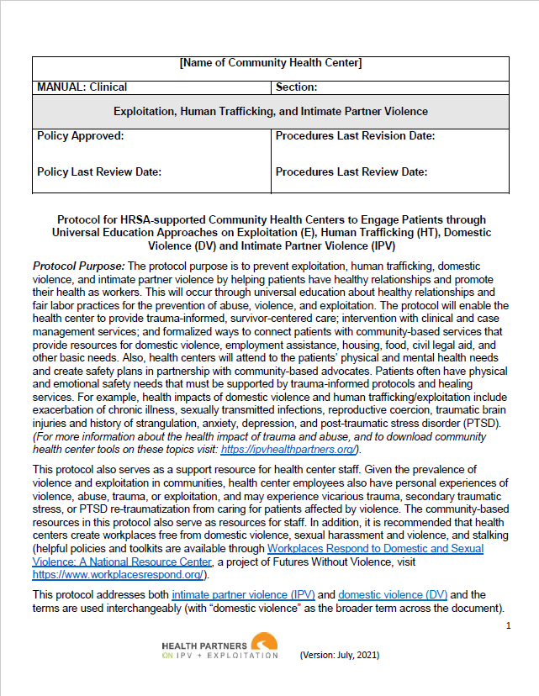
Sample Protocol
Protocol Elements
Descriptions of terms
Clinic policies (language access, privacy, confidentiality)
Training requirements
Universal education framework / CUES
Resources/support services partnerships
Scripts
Reporting requirements
Documentation and coding guidelines
https://healthpartnersipve.org/futures-resources/sample-health-center-protocol/

Slide 38
Trauma Informed Workplaces
FUTURES’ Workplaces Respond Toolkit
Poster for the workplace
Safety Card for Employees
Protection Order Guide For Employees
Supervisor Training Video
Quiz
www.workplacesrespond.org
Notes:
Anna
Notes to Trainer: Ask the audience if they have a workplace policy on workplace domestic violence/sexual harassment, IPV, or human trafficking to support staff who are survivors? If not, recommend they visit the websites listed on the slides to help establish them. There are also accompanying tools to help supervisors to further support their staff. Share that the online toolkit mentioned earlier—IPVHealthPartners.org—also offers model community health center IPV protocols that they can adapt.
Additional Info:
Creating Workplaces Free from Domestic Violence, Sexual Harassment & Violence, and Stalking, Workplaces Respond provides resources, training, and technical assistance to employers, survivors, co-workers, and advocates to prevent and respond to domestic violence, sexual harassment & violence, trafficking, and stalking impacting the workplace. www.workplacesrespond.org
A step by step toolkit that includes model policies and protocols, www.ipvhealthpartners.org was designed to address intimate partner violence by and for community health centers in partnership with domestic violence programs.

Slide 39
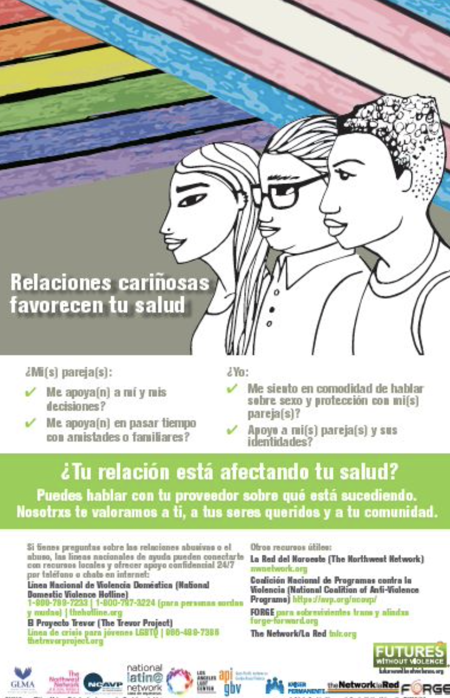
Healing Centered Environment
Space to see patients alone for part of the visit
Affirming visuals for queer + trans patients, language access, healthy relationships
Getting consent before weighing patients
Welcoming and comfortable environment
What else?

Slide 40
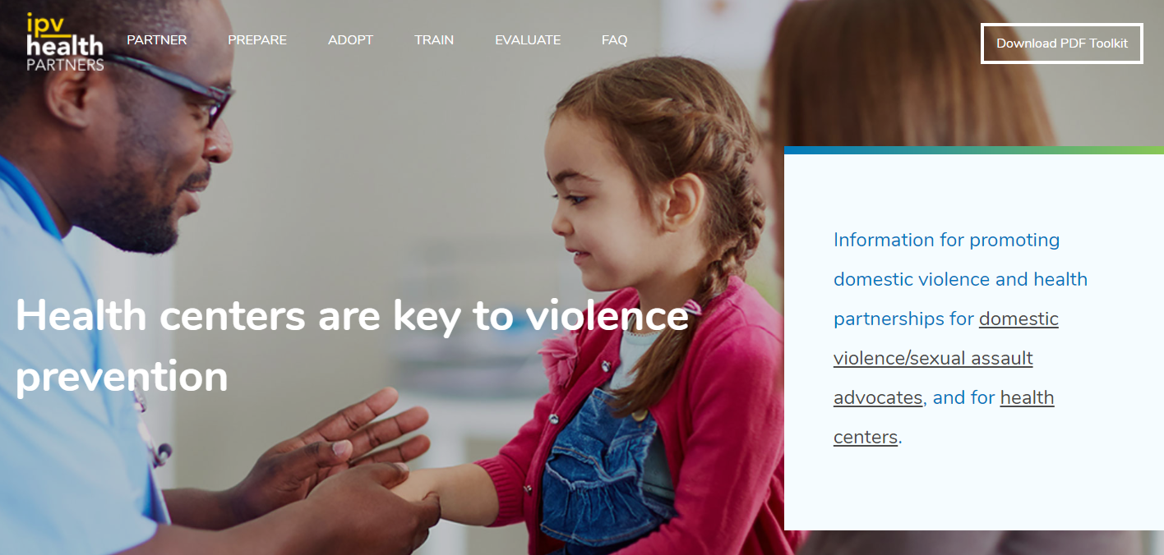
www.IPVHealthPartners.org online toolkit + CUES
Guidance on:
Enhancing patient privacy
Disclosing limits of confidentiality
Universal education scripts
Reaching friends and family
Disclosures + supportive messages
Warm referrals to local DV programs
Safely sharing resources
Tech privacy tips
www.ipvhealthpartners.org
Developed by and for community health centers in partnership with domestic violence programs
+ New guidance on COVID-19 and telehealth support
Notes:
Anna, 1 minute
Notes to Trainer: Share that this online toolkit is the go-to resource for the audience to learn more and find related tools and resources related to today’s training. www.ipvhealthpartners.org was developed by Futures Without Violence in an earlier Project Catalyst phase of work informed by twenty participating community health centers and domestic violence advocacy programs.
You can learn more about CUES at www.IPVHealthPartners.org which walks you through each of the steps in more detail and provides you with additional guidance like the types you see listed here on the slide: including pointers to enhance patient privacy during virtual health visits...sample scripts...providing guidance on universal education and how to respond to disclosures... and considers principles like patient privacy and ways to share resources safely, as well as pointers for patients to enhance their own privacy, or digital footprint. And another big piece of guidance that we offer on this online toolkit is how health center staff can partner with local DV programs, as Anisa discussed...and this supports the opportunity for health care staff to offer patients a warm referral to a local domestic violence program...letting their patients know a little about what the program offers and the role of an advocate and how to reach them.

Slide 41
Self-Reflection
What needs to be in place for implementation at your clinic?
Where are 2 assets that already exist in your setting?
What are 2 growth areas?
What are the next steps you can take to move towards implementing CUES in your setting?

Slide 42
Thank You!
Please open the link that’s posted in the chat box and complete the post-survey.
5 minutes to fill out evaluation and take a break!
Notes:
Anna, 1 minute and close
Notes to Speaker: Share your closing thoughts and thank participants for their time, expertise, and dedication to making a difference for the individuals, families and communities they work with. Be sure to include your contact information, so participants can contact you for further information or questions. Additionally, offer final thanks to key partners who helped with outreach and with mobilizing staff attendance, etc.
Add to the slide the name/email for trainer(s).

