Slide 1
CUES: Confidentiality, Universal Education + Support
An evidenced based intervention for Intimate Partner Violence,
Sexual Violence, and Human Trafficking
Ambulatory CORC Quarterly Focused Discussion
7/25/2025

Slide 2
Introductions
Sharon Smith, LPC (she/her)
Clinical Informaticist
OCHIN
Lisa James (she/her)
Vice President – Health
Futures Without Violence
Jake Sese, MPH (he/him)
Program Assistant – Health Team
Futures Without Violence
Yeshe Mengesha, MPH (she/her)
Director of Health Services
AACI - San Jose, CA
Chetan Gujarathi
QA Manager
AACI – San Jose, CA
This material contains confidential and copyrighted OCHIN and Epic Systems information © Copyright 2025 OCHIN, Inc. © Copyright 2025 Epic Systems Corporation. All rights reserved. FOR COLLABORATIVE USE ONLY
Notes:
Sharon + all: Introduce selves in order

Slide 3
Agenda
Why address IPV and CUES intervention- Lisa James, Jake Sese
OCHIN CUES Pilot and Tool Development - Sharon Smith
Implementation Successes and Lessons Learned: Yeshe Mengesha, Chetan Gujarathi
What’s Next and Resources – Sharon Smith
Q/A
This material contains confidential and copyrighted OCHIN and Epic Systems information © Copyright 2025 OCHIN, Inc. © Copyright 2025 Epic Systems Corporation. All rights reserved. FOR COLLABORATIVE USE ONLY
Notes:
Sharon
Request note/ hold questions (time at end)

Slide 4
Interpersonal Violence (IPV) and the CUES Intervention
Presented by: Lisa James and Jake Sese
Futures Without Violence (FUTURES)

Slide 5

Health Partners on IPV + Exploitation
Led by Futures Without Violence (FUTURES) and funded by HRSA’s Bureau of Primary Health Care to work with health centers to support those at risk of experiencing or surviving intimate partner violence, human trafficking, or exploitation and to bolster prevention efforts.
We offer health center staff ongoing educational programs including:
Trainings on key topics for small cohorts
Webinars + archives
Clinical and patient tools, an online toolkit, evaluation + EHR tools
Learn more: www.healthpartnersipve.org

Slide 6

What is Intimate Partner Violence (IPV)?
A person(s) in a relationship is using a pattern of methods and tactics to gain and maintain power and control over the other person.
It is often a cycle that gets worse over time – not a one-time ‘incident’
Abusers use jealousy, social status, mental health, money, and other tactics to be controlling and abusive – not just physical violence
Leaving an abusive relationship is not always the best, safest, or most realistic option for survivors

Slide 7
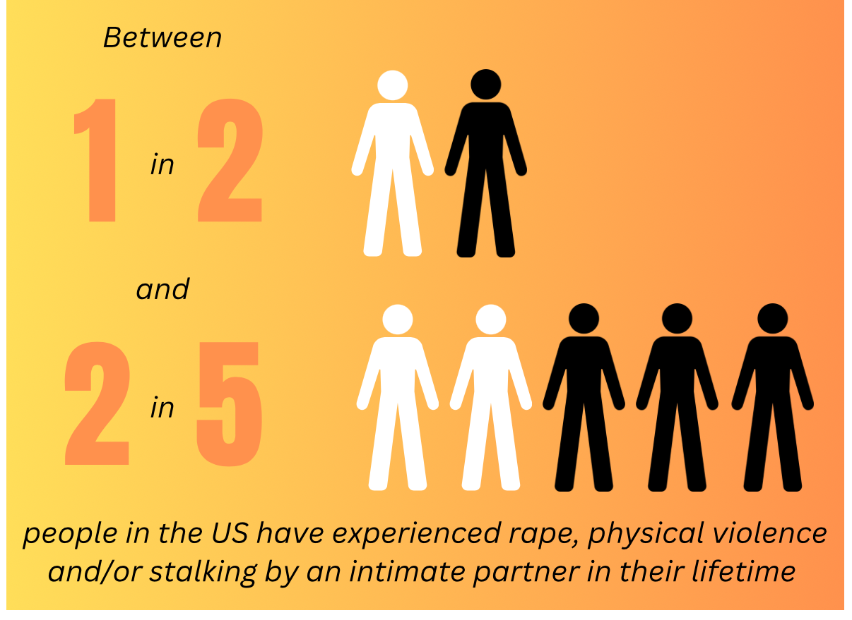
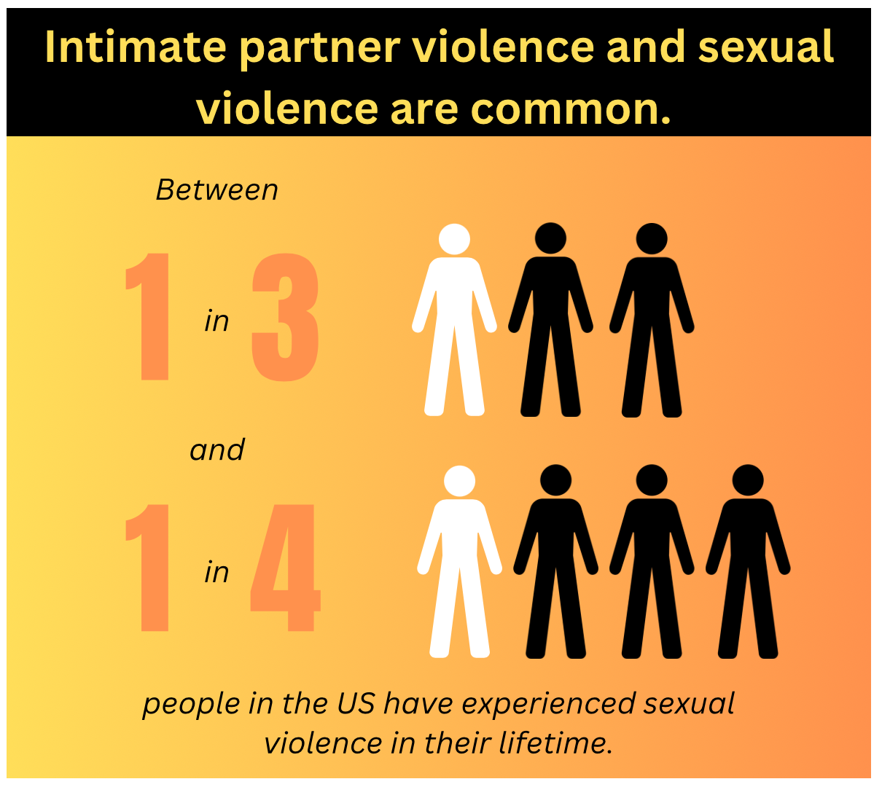
Prevalence
Intimate Partner Violence
Sexual Violence
The National Intimate Partner and Sexual Violence Survey 2016/2017 Report on Intimate Partner Violence

Slide 8
Health Impact of IPV
Anxiety, Depression, PTSD
Asthma
Barriers to healthcare
Bladder and kidney infections
Cardiovascular problems
Gastrointestinal issues
Chronic pain syndromes
Sleep Problems
STIs and HIV
Suicidality
Unintended Pregnancies
Intimate Partner Violence

Slide 9

IPV UDS measures added in 2020
https://bphc.hrsa.gov/data-reporting/uds-training-and-technical-assistance

Slide 10
ICD-10 Codes for Intimate Partner Violence
IPV ICD-10 Codes
T74.11 – Adult physical abuse, confirmed T74.21 – Adult sexual abuse, confirmed T74.31 – Adult psychological abuse, confirmed Z69.11 – Encounter for mental health services for victim of spousal or partner abuse Y07.0 – Spouse or partner, perpetrator of maltreatment and neglect SNOMED CT code for Implementation of CUES 911221000124107 procedure
Notes:
Kim, 1 min

Slide 11
Office of Inspector General report
Only 43% followed the USPSTF recommendation to offer screening and brief intervention for women age 18-44 and referred patients who screened positive for services
Providers reported the following barriers:
Time Constraints
Concerns about Privacy and Reporting
Inadequate Training
https://oig.hhs.gov/reports/all/2024/medicaid-enrollees-may-not-be-screened-for-intimate-partner-violence-because-of-challenges-reported-by-primary-care-clinicians/

Slide 12
IPV Challenges
Optimization Opportunities
Many organizations don’t routinely screen for IPV for all patients
Providers concerned about confidentiality
No standardized IPV documentation or guides
IPV documented in multiple areas for team access
Inconsistent or lack of ICD Coding
Difficulty generating accurate UDS data and other reporting information
Pediatrics may not see documentation in the parent’s chart

Slide 13
How Can We Support Health Centers Working to Identify and Help Survivors and Document and Code Safely?

Slide 14
Rethinking Screening Alone
Low disclosure rates
Not survivor centered
Resources offered only based on a patient’s disclosure
Missed opportunity for prevention education
Notes:
Speaker 2, 1 min. Quick summary points:
Read the slide aloud
Mention that this study showed positive outcomes for women who talked with their providers about the abuse
Script: “So what if we disclosure is no longer the goal? Research has shown for disclosure-driven screening practice that disclosure rates were low, they aren’t survivor-centered, resources were only offered based on a patient’s disclosure, and that it was a missed opportunity for prevention education. In a study by McCloskey et al. (2006), 132 women outpatients who disclosed domestic violence in the preceding year were recruited from multiple hospital departments and community agencies. Abused women who talked with their health care providers about the abuse were more likely to use an intervention and exit the abusive relationship. Women who were no longer with their abuser reported better physical health than women who stayed.”
Source:
McCloskey LA, Lichter E, Williams C, Gerber M, Wittenberg E, Ganz M. Assessing Intimate Partner Violence in Health Care Settings Leads to Women’s Receipt of Interventions and Improved Health. Public Health Reporter. 2006;121(4):435-444.

Slide 15
Shifting Away from Screening…
“No one is hurting you at home, right?” (Partner seated next to client as this is asked – consider how that felt to the patient?)
“Within the last year has he ever hurt you or hit you?” (Nurse with back to you at her computer screen)
“I’m really sorry I have to ask you these questions, it’s a requirement of our clinic.” (Screening tool in hand -- What was the staff communicating to the patient?)

Slide 16




CUES: An Evidence Based Intervention
C: Confidentiality
See patient alone, disclose limits of confidentiality
UE: Universal Education
Normalize activity
Make the connection—open the card and do a quick review
Give 2 copies of a resource to the patient—one to share with a friend or family member
S: Support
Provide a "warm referral" to your local domestic/sexual violence partner agency or national hotlines
Safety cards are available for different settings, communities and in a variety of languages at https://store.futureswithoutviolence.org/product-category/product-type/brochures-safety-cards/
CUES: Confidentiality, Universal Education and Support infographic

Slide 17


Universal Education
Provides an opportunity for clients to make the connection between violence, health problems, and risk behaviors.
* If you currently have IPV/HT screening as part of your health center requirements: we strongly recommend first doing universal education.
Notes:
Rebecca, 1 minute and when finished reading slide turn to Anna for a stretch
Notes to Trainer: Read aloud “Our contribution to helping support health equity is universal education. Universal education approach for IPV/HT offers support to those:
who have never experienced IPV/HT
who are currently experiencing IPV/HT
who may have a lifetime history of IPV/HT.”
Say “we’re going to pause for a minute here reaching this introduction to universal education…and Anna’s going to lead us all through a stretch to wake up our minds and bodies a little before we move into our CUES approach. Anna…”
Additional Points:
May share that it’s an opportunity for providers or health staff to share their power with patients such that they will no longer have to first receive something from a patient (such as a disclosure about violence/abuse) in order to give something over (which is resources that can lead to safety and health improvements). Recognize that this power shift changes how providers previously were limited in giving information/referrals and to the patients who said ‘yes’ (disclosure). Universal education is an opportunity to better share/exchange power with patients and for them to know that they can disclose, or not...and still receive lifesaving safety and health information and referrals.

Slide 18
C: Confidentiality: “We always see patients alone”
Know your state or territories’ reporting requirements and share any limits of confidentiality with your patients.
Ensure that you can bring up relationships, violence, or stress safely by seeing patients alone for at least part of every visit.
Key Resources:
“Seeing patients alone” video vignette: https://youtu.be/Mvxem3WwQaY
Compendium of State and U.S. Territory Statutes and Policies on Domestic Violence and Health Care: https://ipvhealthpartners.org/faqs/#health-reporting

Slide 19
UE: Universal Education
"I've started giving two of these cards to all of my patients—in case you are ever struggling in a relationship or if you feel like someone is taking advantage of you - and also so you have the info to help a friend or family member.”
Give each patient two safety cards to start the conversation about relationships and how they affect health.
Open the card and encourage them to take a look. Make sure patients know that you’re a safe person for them to talk to.
Key Resources:
CUES Intervention (shortened): https://youtu.be/vqQ0CqMDy-s
Provider Discussion of Safety Card Intervention: https://youtu.be/-SS1XzO_Rqc
Universal education, patient talks about sister: https://youtu.be/_N-llCsnGSI
Universal Education and Screening for Intimate Partner Violence in a Reproductive Health Setting: https://youtu.be/bnhx3Hwf_hs

Slide 20
S: Support
“I am so grateful that you shared that with me. Thank you for trusting me with your story.” ​
​ “I hear you saying that things are complicated. Would you like me to offer some thoughts on what other young people have found helpful? I’m also ok with just listening as well.”
Make a warm referral to your local domestic/sexual violence partner agency or national hotlines (on the back of all safety cards).
Offer health promotion strategies and a care plan that takes surviving abuse into consideration.
Key Resources:
CUES Follow-Up: Warm referral: https://youtu.be/G_l3iCgtVcM
CUES Follow-Up: Offering support: https://youtu.be/rycKRAPZtQE
Universal Education and Screening for Intimate Partner Violence in a Reproductive Health Setting (Support piece): https://youtu.be/bnhx3Hwf_hs?t=242

Slide 21
S: Support -
Important Reminder:
Though disclosure of violence is not the goal, it will happen -- know how to support someone who discloses.

Slide 22

The DV hotline is also there for YOU:
To provide guidance, discuss cases and discuss resources and expertise
Leaving is not the goal (More dangerous?!)
The goal is to reduce isolation
DV Advocates can support you and your patient to navigate resources and support survivors with their identified priorities
Notes:
1 min
Note to Trainer: Read the slide aloud. You can add, “If you do get a closure know you are not alone the DV hotline is for practitioners too, not just clients.”

Slide 23
Healing-Centered Care when Documenting IPV/HT
For information on key elements of IPV documentation - http://ipvhealthpartners.org/wp-content/uploads/2017/02/Documentation.pdf
Consider safety of the patient by those accessing information in the record
Respect for patient’s autonomy and concerns
Informed consent: Inform patients about how the health information will be handled
Patient participation in deciding how to document (under the limits of relevant laws/policies)
If you have to report – follow healing-centered reporting suggestions
Notes:
When deciding on the approach to patient confidentiality in use of ICD codes and inclusion of sensitive information in records, the provider should consider there basic tenets of healing-centered care:
Safety of the patient from harm by those accessing information in the record
Respect for the patient’s autonomy as well as their concerns and wishes
Informed consent: patients need information about how health information is handled, including pro’s and con’s of documentation. They need to be empowered to participate in making decisions about documentation (under the limits of relevant laws/policies).
Pro’s of including sensitive information in the EHR:
Continuity and optimization of patient’s care with future clinicians; it may assist providers in obtaining relevant resources for patient now and in the future as patient needs change; may help keep patient safe in the hospital if there are concerns that the trafficker will come to find them; may help with an investigation ; on a larger scale, tracking patients who have been trafficked helps to ensure that your community gets the resources they need to serve exploited persons. The government needs to know where trafficking occurs in order to direct resources there .
Con’s of including sensitive information:
If information appears in the patient portal, a proxy (typically the guardian) or trafficker may obtain access to info. and may harm patient; staff reading sensitive info may adopt bias/discrimination in treatment of patient; patient may feel shame or other negative emotions regarding the info; information may be used against patient in legal proceedings;
ICD 10 codes should be used when we have the patient’s permission OR if/when mandated reporting applies.

Slide 24
EHR Optimization Needs
Confidential documentation to avoid harm
Securely share information with internal clinical staff
Prevent IPV information from causing harm to the patient
Portal, Claims, Referrals, etc.
Referral and warm handoff
Reminder indicating annual IPV screening is due
Clinical Alerts
Generate UDS and population health reporting based on ICD Codes

Slide 25
OCHIN EPIC CUES Pilot and
Tool Development
Presented by: Sharon Smith (OCHIN)

Slide 26
CUES Pilot
In 2022, SA182 Asian Health Services piloted the CUES workflow within OCHIN Epic informed by Future’s Without Violence’s evidenced-based CUES intervention
Tools for In Person and Virtual visits
Scripts
OPAs
Flowsheets
Pathways for Privacy
This material contains confidential and copyrighted OCHIN and Epic Systems information © Copyright 2025 OCHIN, Inc. © Copyright 2025 Epic Systems Corporation. All rights reserved. FOR COLLABORATIVE USE ONLY
Notes:
Sharon

Slide 27
CUES Within OCHIN’s Electronic Health Record
Document
Confidentiality - if the person had privacy for the conversation
If and how Universal Education was provided
CUES informed Scripts available for various settings, including if disclosure happens to ensure support
Clinical Decision Support + Reporting
Our Practice Advisory - available to assist with the CUES workflow
CUES SmartTools - aligned with UDS reporting for suspected and confirmed diagnostics
This material contains confidential and copyrighted OCHIN and Epic Systems information © Copyright 2025 OCHIN, Inc. © Copyright 2025 Epic Systems Corporation. All rights reserved. FOR COLLABORATIVE USE ONLY
Notes:
Sharon
- evaluated SAs using CUES in OCHIN – AACI most prolific user
- I will share resources links at the end that include details/ visuals of the tools + training

Slide 28
Implementation
Successes and Lessons Learned
Presented by: Yeshe Mengesha and Chetan Gujarathi (SA249 AACI)

Slide 29
CUES in Practice
Use brief, non-judgmental language: “We give this card to all our patients because relationships affect health.”
Offer a brochure/card discreetly.
Normalize information-sharing regardless of disclosure.
Rooming Patient Alone - All staff trained on how to facilitate rooming patients alone.
CUES information posted in restrooms.
This material contains confidential and copyrighted OCHIN and Epic Systems information © Copyright 2025 OCHIN, Inc. © Copyright 2025 Epic Systems Corporation. All rights reserved. FOR COLLABORATIVE USE ONLY
Notes:
Yeshe/ Chetan

Slide 30
Importance of Allocating Time for Positive Disclosures
When a patient responds positively:
Extra time is essential for safety planning and emotional support
MA/Provider informing the Care team to see if other providers can see pt, call DV team etc.
Key Recommendation:
Implement a “warm hand-off” protocol and ensure same-day access to IBH provider
This material contains confidential and copyrighted OCHIN and Epic Systems information © Copyright 2025 OCHIN, Inc. © Copyright 2025 Epic Systems Corporation. All rights reserved. FOR COLLABORATIVE USE ONLY
Notes:
Yeshe/ Chetan

Slide 31
Team Support for Secondary Harm
Exposure to IPV stories can lead to vicarious harm or burnout.
Normalize emotional response among providers and staff.
A few Recommendations:
Create debriefing opportunities.
Offer supervision and peer support.
Onsite and Offsite support for staff and patients for warm hand-off / referral
Leadership buy-in. Executive team committed to this cause
This material contains confidential and copyrighted OCHIN and Epic Systems information © Copyright 2025 OCHIN, Inc. © Copyright 2025 Epic Systems Corporation. All rights reserved. FOR COLLABORATIVE USE ONLY
Notes:
Yeshe/ Chetan

Slide 32
Implementation Strategies
Train all staff in CUES and healing-centered care.
Include CUES prompts in EHR workflows.
Partner with local DV advocacy organizations (for AACI we have internal DV program)
Evaluate impact and collect feedback regularly from all care team members of the HC.
This material contains confidential and copyrighted OCHIN and Epic Systems information © Copyright 2025 OCHIN, Inc. © Copyright 2025 Epic Systems Corporation. All rights reserved. FOR COLLABORATIVE USE ONLY
Notes:
Yeshe/ Chetan

Slide 33
Challenges & Solutions
Challenge: Time constraints
Solution: Integrate CUES into routine visits, use team-based care.
Challenge: Provider discomfort
Solution: Ongoing training and peer mentorship.
Challenge: Resource limitations
Solution: Build community partnerships and seek grant support.
This material contains confidential and copyrighted OCHIN and Epic Systems information © Copyright 2025 OCHIN, Inc. © Copyright 2025 Epic Systems Corporation. All rights reserved. FOR COLLABORATIVE USE ONLY
Notes:
Yeshe/Chetan

Slide 34
Key Takeaways
CUES enables patients without forcing disclosure.
Though CUES doesn’t push for disclosure, this approach builds trust and 73% of patients with CUES intervention at our health center disclosed IPV (much higher than screening disclosure rates).
Providers need time and support for meaningful response.
Care teams must be equipped to handle secondary harm.
Implementation is a shared responsibility that improves care for all.
This material contains confidential and copyrighted OCHIN and Epic Systems information © Copyright 2025 OCHIN, Inc. © Copyright 2025 Epic Systems Corporation. All rights reserved. FOR COLLABORATIVE USE ONLY
Notes:
Yeshe/Chetan

Slide 35
What’s Next & Resources
Presented by: Sharon Smith (OCHIN)

Slide 36
CUES - What’s Next | Target date
E-Learning training video for any OCHIN Member | Fall 2025
Update Design Sessions | Fall 2025
Build Updates | Spring 2026
Documentation of Updated Tools | Spring 2026
This material contains confidential and copyrighted OCHIN and Epic Systems information © Copyright 2025 OCHIN, Inc. © Copyright 2025 Epic Systems Corporation. All rights reserved. FOR COLLABORATIVE USE ONLY
Notes:
Sharon
Angie Brown and Lulu Gonzalez: new training build
Mindy Saechao: CUES build updates in EPIC, include updated codes in flowsheet to support intervention and diagnosis
Spring 2026: written materials and updates released, including added segment to the learning video

Slide 37
Current CUES Resources and Links
ELLA: CUES Recorded Presentation/ Training
ELLA: CUES Screening and Documentation in an Encounter
ELLA: CUES Workflows for In Person and Virtual Visits
OCHIN Central: HCCN Toolkit, CUES Intervention
Local Resources:
Interpersonal Violence Programs
Community Centers
Housing support
Etc.
To turn on current CUES build for your SA (flowsheets, OPAs, scripts) :
complete recorded training above
submit a Jira
This material contains confidential and copyrighted OCHIN and Epic Systems information © Copyright 2025 OCHIN, Inc. © Copyright 2025 Epic Systems Corporation. All rights reserved. FOR COLLABORATIVE USE ONLY
Notes:
Sharon
Put links in chat
Current Action: training (above or contact FUTURES) then submit Jira request to turn on build
OCHIN HCCN Members can access the HCCN toolkit

Slide 38
Thank you!
Questions?

