Slide 1



Economic and Health Needs of Survivors of
Human Trafficking
Thursday, January 29, 2026
Spanish and ASL interpretation available.
Interpretación en español y ASL disponible.

Slide 2


How To Access Language Interpretation on Zoom
Cómo Activar la Interpretación
de Idiomas en Zoom

Slide 3
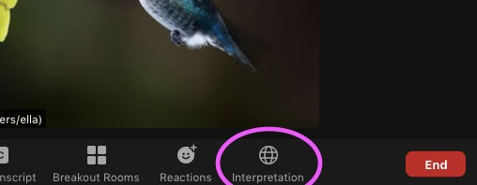

On your computer, find the Interpretation Globe Icon at the bottom of your screen
En su computadora, busque el globo terráqueo que dice Interpretación en la parte inferior de su pantalla.

Slide 4
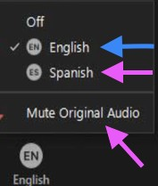
Choose English as your language. Make sure to NOT mute original audio so that you can hear the main room
Seleccione Español. Asegúrese de Silenciar Audio Original, si solo desea escuchar al intérprete

Slide 5
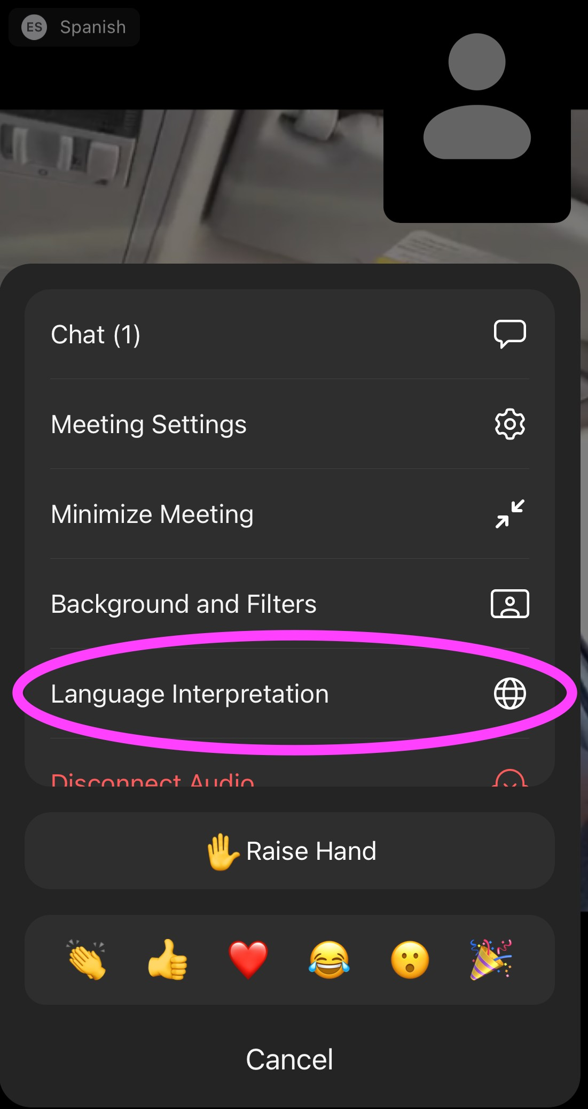
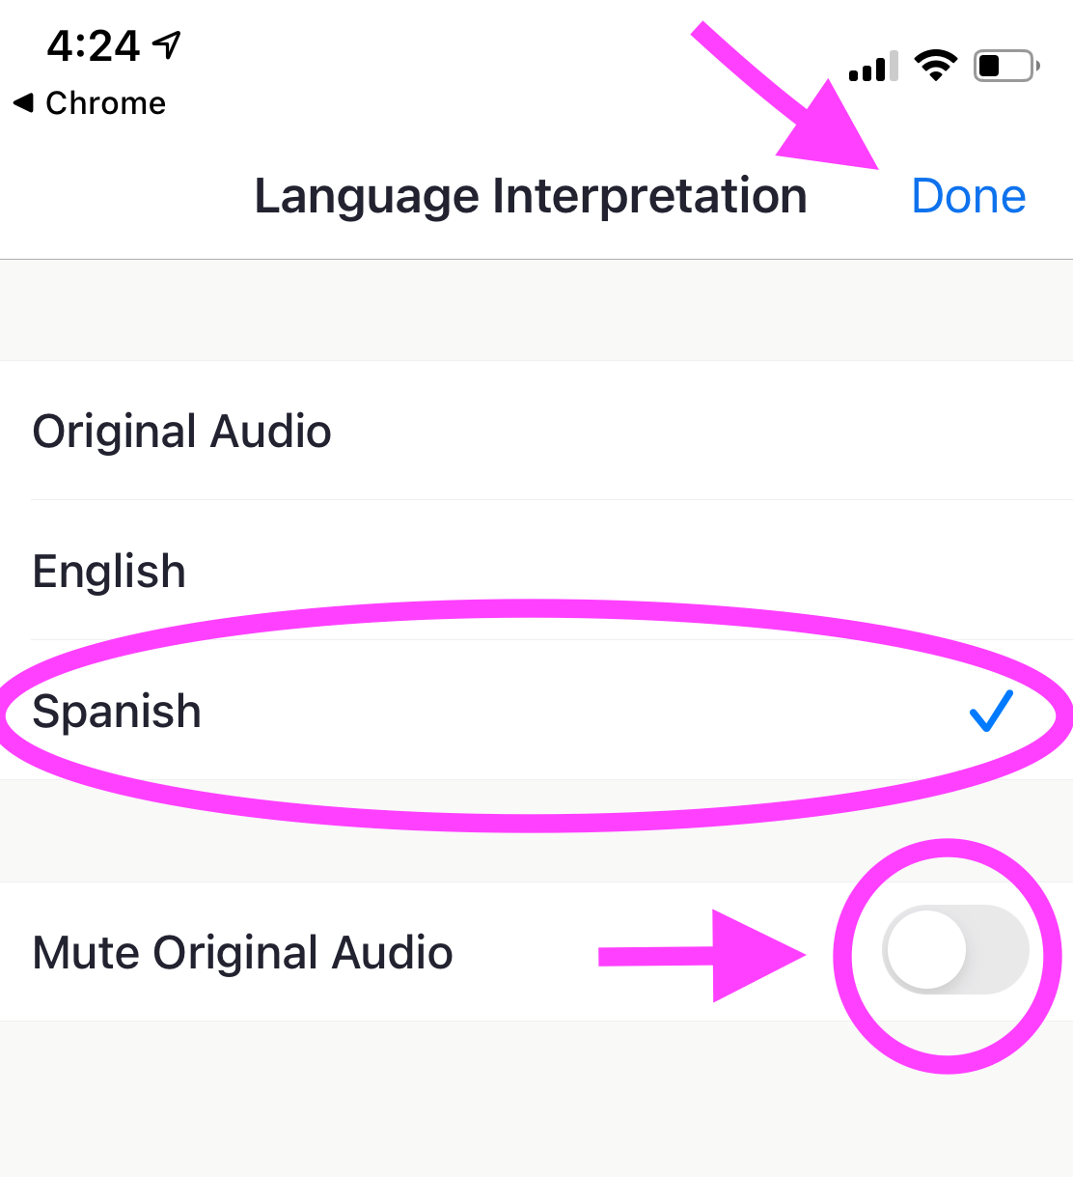
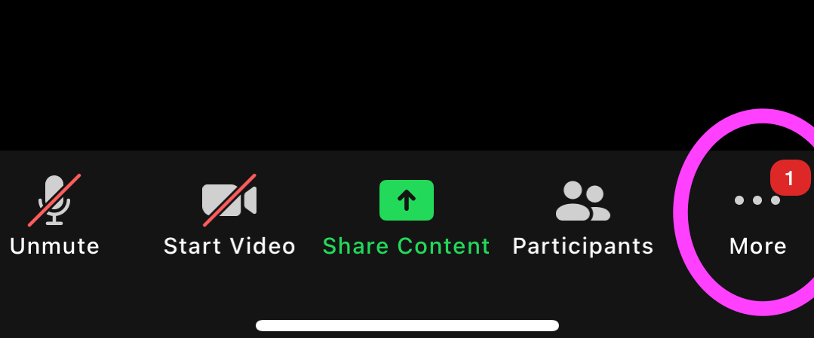
If you are on a smart device, look for the three dot menu and choose Language Interpretation.​
Then, select English.
Interpretation is not available from a Chromebook or if you dial into Zoom.
Desde un dispositivo inteligente, busque el menú de tres puntos y elija Interpretación. Después, escoja “Español” y silencie el audio original.​
No podrá acceder a la interpretación a través de un Chromebook o si marca por teléfono a la reunión de Zoom.

Slide 6

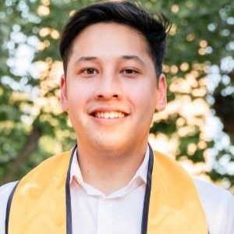


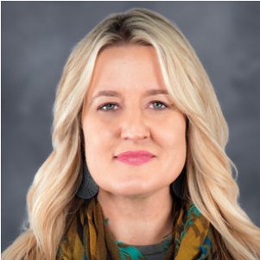
Faculty & Speakers
Anna Marjavi
Director
Health Partners on IPV+E
Futures Without Violence
Jake Sese, MPH
Program Associate
Health Partners on IPV+E
Futures Without Violence
Carolyne Ouya
Program Manager
Workplace &
Economic Opportunity
Futures Without Violence
Kimberly Chang, MD, MPH
Family Physician and Consultant
Asian Health Services
Health Partners on IPV+E
Futures Without Violence
Amy Young-Snodgrass, MD, FAAP
Chief, Forensics
Loma Linda University Children’s Hospital

Slide 7

Health Partners on IPV + Exploitation
Led by Futures Without Violence (FUTURES) and funded by HRSA’s Bureau of Primary Health Care to provide technical assistance to health centers to develop and implement evidence-based strategies, protocols, and partnerships to prevent, identify, and respond to intimate partner violence and human trafficking.
We offer health center staff ongoing educational programs including:
Communities of practice on key topics for small cohorts
Live webinars + an archive
Clinical and patient tools, including for electronic health records (EHRs)
Evidence-based approaches including our CUES Intervention
Learn more: www.healthpartnersipve.org

Slide 8
Workplace & Economic Opportunity Team
We work to ensure women, families, and all people can pursue economic choice, dignified employment and freedom from violence.
Key Initiatives:
Workplace Responds National Resource Center
Advancing Safety Through Employment Rights
Pathways to Opportunity Regional Economic Mobility Hubs
Learn more: workplacesrespond.org

Slide 9
Agenda
Level setting and definitions
  Human trafficking (HT) and exploitation (E) dynamics
  Health impacts of HT/E
Discussion Part 1
  HT/E prevention and precursors to employment/economic stability
Discussion Part 2
  Needs of HT/E survivors
  Specific strategies for survivor employment support

Slide 10
Learning Objectives
At the end of this webinar, attendees will be able to:
Describe the economic and employment needs of human trafficking survivors and their connection to safety and security.
Identify two strategies that health centers can implement to create employment pathways for survivors.
Define the mental health needs of human trafficking survivors and how health centers and their partners can address them.

Slide 11

Human Trafficking and Exploitation: Definitions and Dynamics
A Case Study
“He said that he would fire me, my husband, my brother-in-law, and all the employees at the restaurant!”

Slide 12
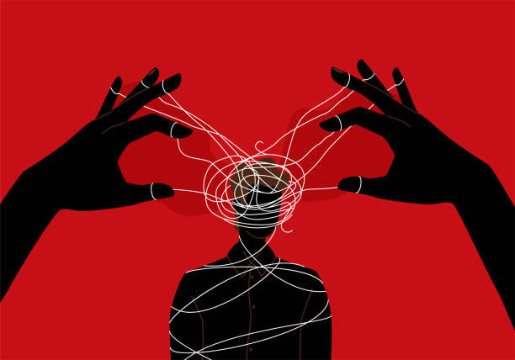
Underlying Dynamics of Human Trafficking and Exploitation
Power and Control
With a Profit Motive

Slide 13
Labor Exploitation, Labor Violations, Labor Trafficking:
A Spectrum of Experiences
Labor exploitation: an employer unfairly benefits from employee’s work. Labor exploitation is not a legal term—in fact, not all forms of labor exploitation are illegal.
Labor Exploitation
Labor Violations
Labor violations: a legal term used when employers violate federal, state, or municipal laws related to worker treatment, workplace safety, or recordkeeping requirements.
Labor Trafficking

Slide 14
Sexual Violence, Sexual Exploitation, Sex Trafficking: A Spectrum of Experiences
Sexual Violence: includes rape, sexual assault, sexual harassment, nonconsensual image sharing, incest, child sexual assault, public masturbation, watching someone engage in private acts without their consent, unwanted sexual contact/touching.
Sexual Violence
Sexual Exploitation
Sexual Exploitation: Actual or attempted abuse of a position of vulnerability, power, or trust, for sexual purposes, including, but not limited to, profiting monetarily, socially or politically from the sexual exchanges:
Coercion from employers/workplace
Coercive rent/debt exchange
Trading drugs
Sex Trafficking

Slide 15
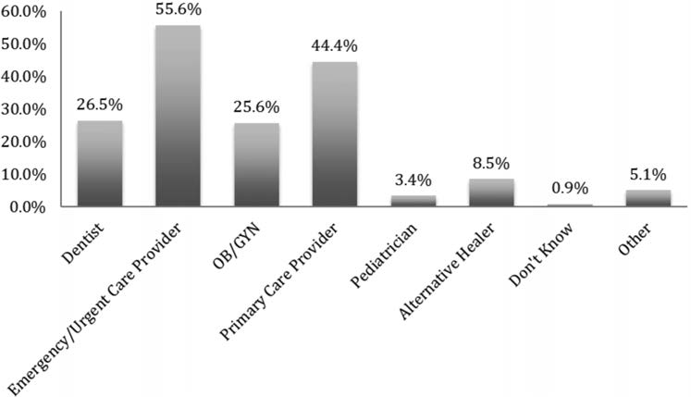
Survivor Interactions with Healthcare
Victims encounter a variety of health care professionals while being trafficked.
Percentage of victims* who came in contact with health care professionals (by specialty)
While being trafficked:
87.8% of trafficked victims encountered a health care provider and 57.1% visited a clinic
None were identified as being trafficked.
(Lederer et al. 2014)
(Chisolm-Straker et al. 2016)
*Some patients had received services from multiple categories of providers

Slide 16
Health Issues that Lead to Encounters with Healthcare for HT Victims/Survivors
Emergent Medical Conditions
  Profuse bleeding or pain caused by a beating or forced termination, injury on a job site, or complications during pregnancy, such as an ectopic pregnancy
  Severe wound infections with signs of septicemia
Gynecological Services
  For sexually transmitted infections
Late or No Prenatal Care
(Toney-Butler TJ, et al. 2023)

Slide 17
Health Issues that Lead to Encounters with Healthcare for HT Victims/Survivors Continued
Substance use and addiction issues
  Such as a severe overdose or withdrawal signs and symptoms
Mental health problems
  Depression, suicide attempts, or anxiety disorder
Somatizing of mental distress
  Headaches, stomach aches, fatigue, dizziness
Dental emergencies
Musculoskeletal injuries
Plastic surgery consultations
(Toney-Butler TJ, et al. 2023)

Slide 18


HT and Behavioral Health
Anxiety and/or depression
Panic disorder
Post-traumatic stress disorder (PTSD)
Antisocial behavior
Suicidal behavior
Sleep disturbances
Substance use disorders
Eating disorders
(Conley, et al. 2023)
(Mazeda, et al. 2010)
(Zimmerman, et al. 2011)

Slide 19

Intersection of Health and Economic Security
Common Challenges:
Suffer workplace injuries due to unsafe conditions
Cognitive and physical disabilities that may require workplace accommodations
Co-occurring mental health disorders
Education and work history gaps
Struggling to meet basic needs
Increased vulnerability to exploitation

Slide 20


Exploring Health System Strategies for Prevention and Intervention of Exploitation

Slide 21
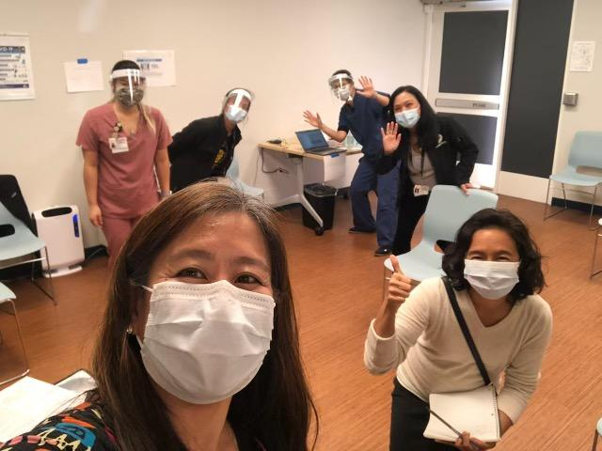
Overview of Health Centers (HCs)
Health centers are community-based and patient-directed organizations that deliver no-cost/low-cost comprehensive primary health care.
They often include:
Pharmacy
Mental health services
Substance abuse programs
Oral health services
Photo: CHC Staff at Asian Health Services in Oakland, CA in 2021
Located in medically underserved areas and for medically underserved populations.
Find a health center here: https://findahealthcenter.hrsa.gov/

Slide 22


RICA
11374 Mountain View Ave.
Loma Linda, CA 92354

Slide 23
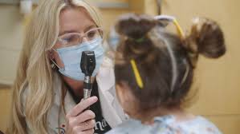
Forensic Pediatrics
Expertise in biomechanics and mechanism of injury
Perform evaluations, diagnosis, treatment and management of cases of child abuse and neglect
Head trauma, organ injury/abdominal injury, fractures, burns, cutaneous injuries, sexual abuse/exploitation, severe neglect, intentional poisonings, child torture, medical child abuse
Three-year fellowship training, board certification in Pediatrics and Child Abuse Pediatrics
Workforce shortage
Expertise in patient-directed care
Provide expert medical testimony

Slide 24
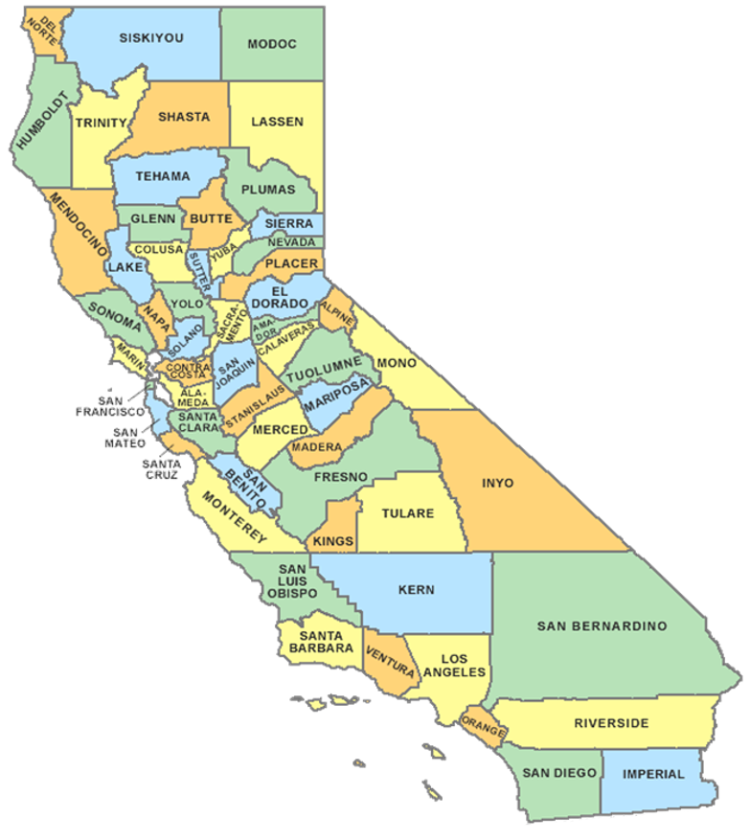
The Loma Linda team covers the largest geographic region in the county
Over 4,000 cases each year
Roughly 25 homicides

Slide 25
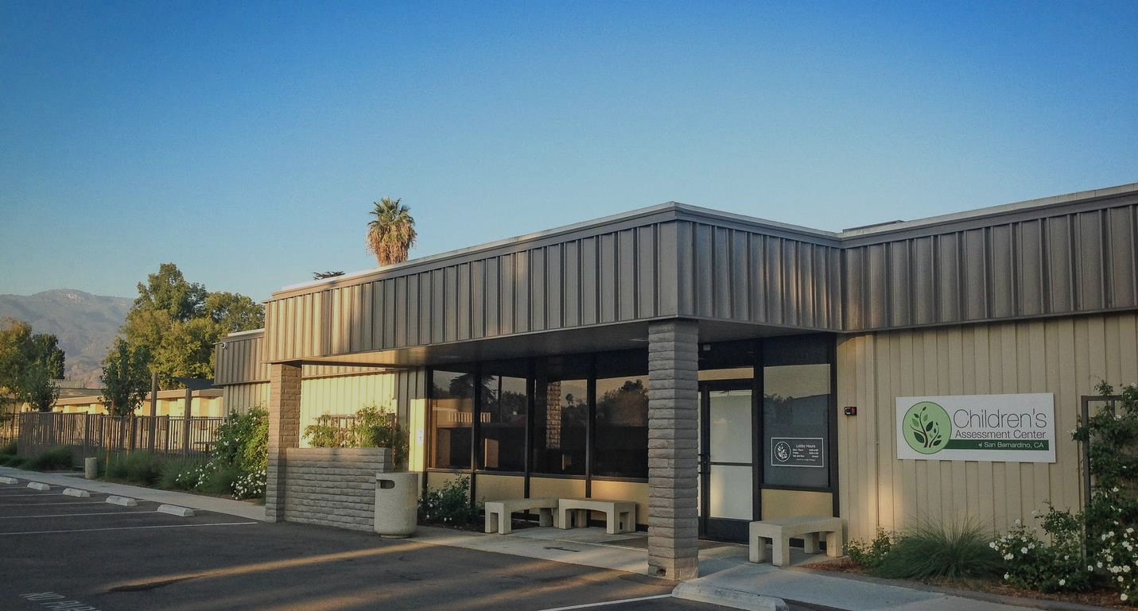
What is the Children’s Assessment Center?
The Children's Assessment Center of San Bernardino is a public and private partnership between San Bernardino County and Loma Linda University Children's Hospital, providing forensic interviews and evidentiary medical examinations to assist in the evaluation of child abuse allegations. The CAC coordinates services in a child-focused atmosphere, thus reducing harm to child victims and their families.

Slide 26

Services
CAC offers multidisciplinary services for suspected child abuse victims including:
Forensic Interviews
Outpatient Forensic Medical Exams
Follow-up for Inpatient Cases
Victim Advocacy
Mental Health Assessments and Referrals

Slide 27

Partnerships
Loma Linda University Children’s Hospital
County of San Bernardino
  Department of Behavioral Health
  Children & Family Services
  District Attorney’s Office
  Sheriff’s Department
  Children’s Network
  First 5
Children’s Fund
Local Police Departments

Slide 28
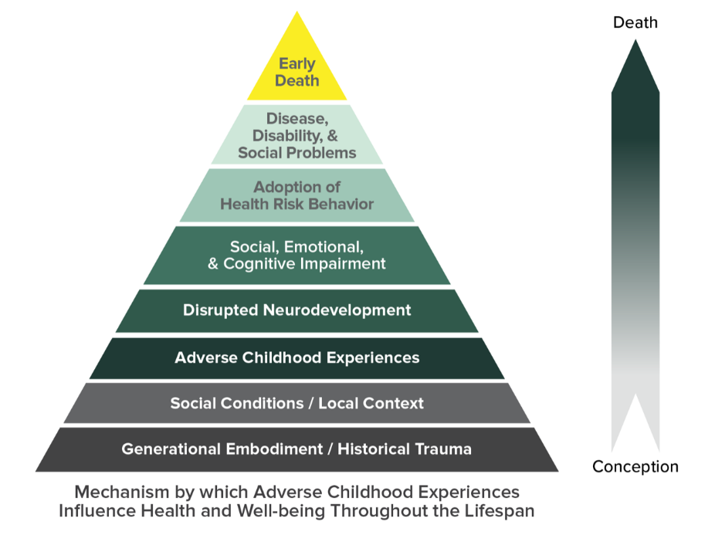
Adverse Childhood Experiences
Physical Abuse
Sexual Abuse
Emotional Abuse
Emotional Neglect
Physical Neglect
Parental Separation/Divorce
Exposure to Violence in the Home
Caregiver with Substance Abuse
Caregiver with Mental Health Concerns
Incarcerated Caregiver

Slide 29
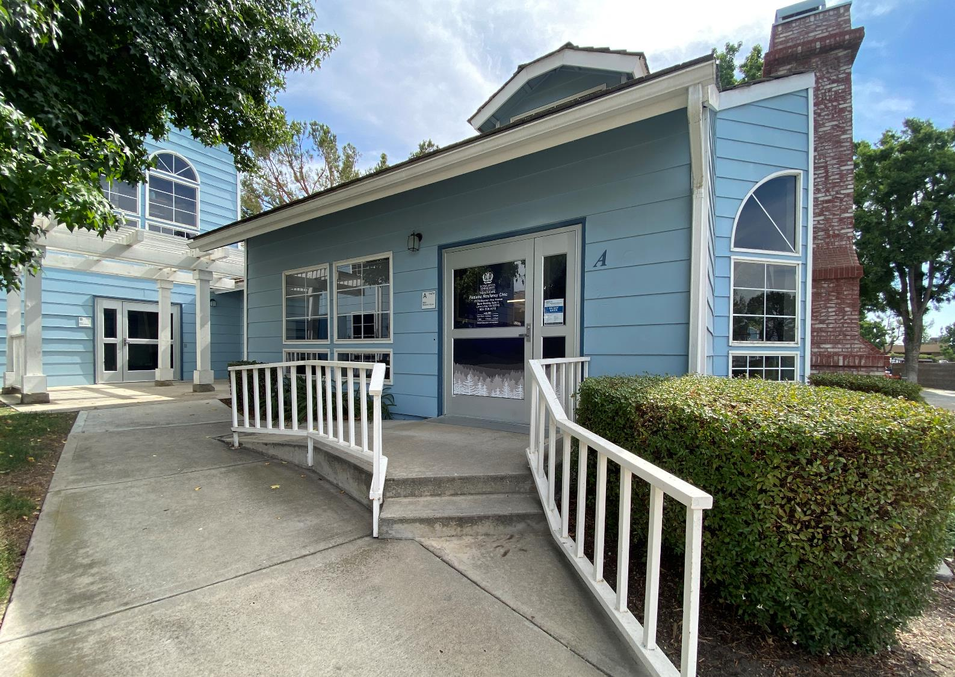
Resiliency Institute for Childhood Adversity (RICA)
Integrated Clinical Services
Interdisciplinary Education
Research

Slide 30
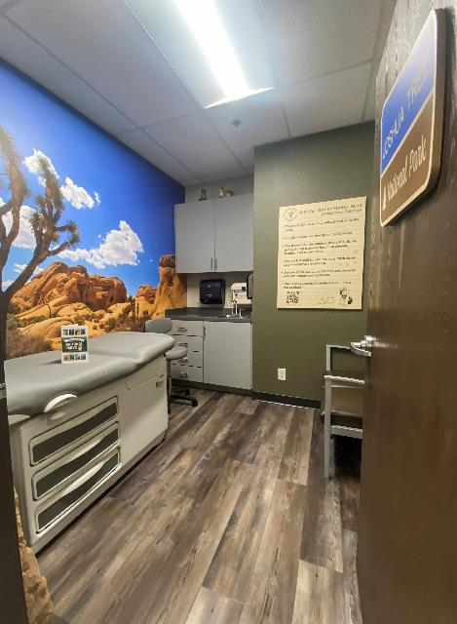

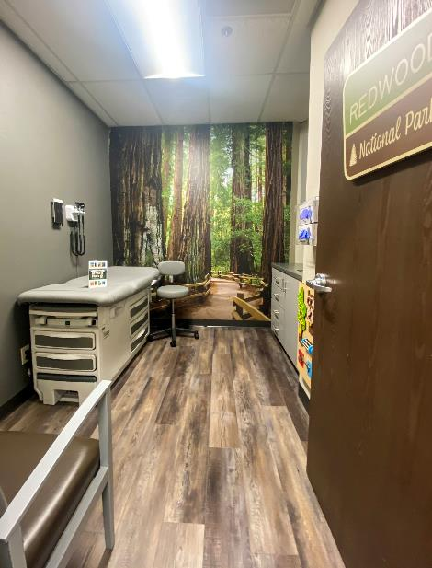


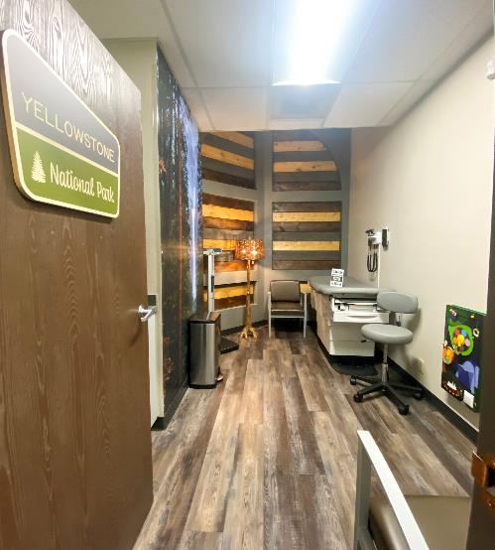
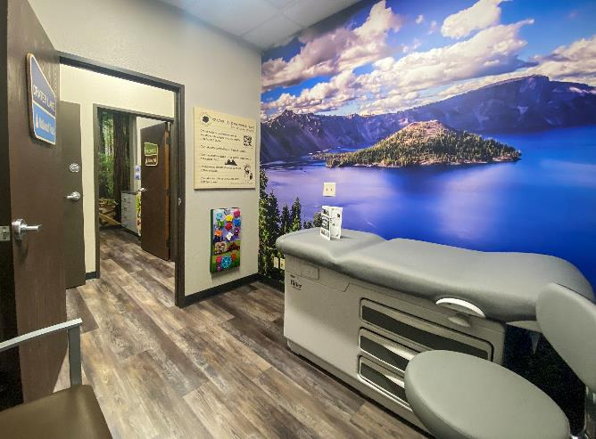



EXAM
ROOMS

Slide 31
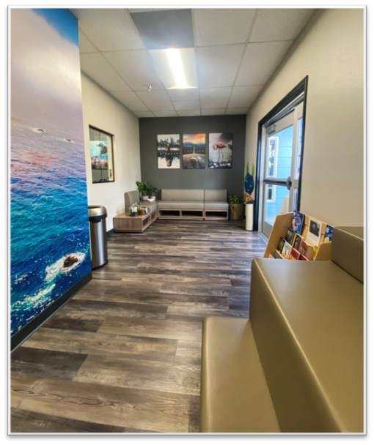
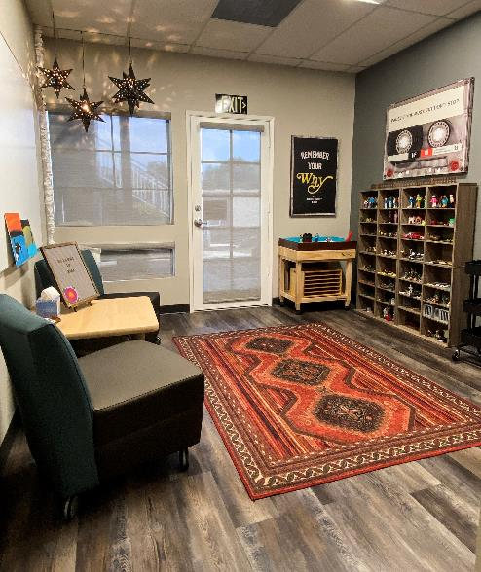


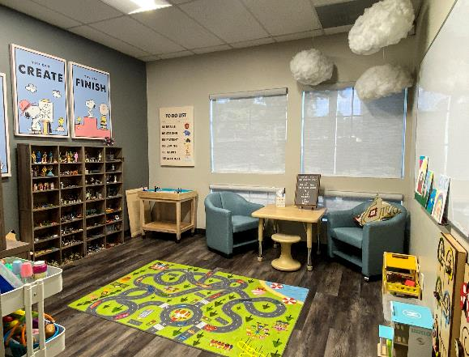
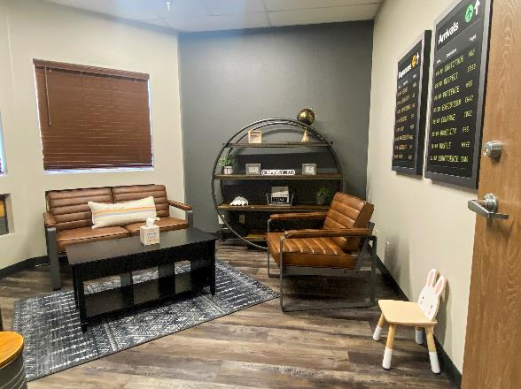

LOBBY
THERAPY ROOM
THERAPY ROOM
FAMILY THERAPY

Slide 32

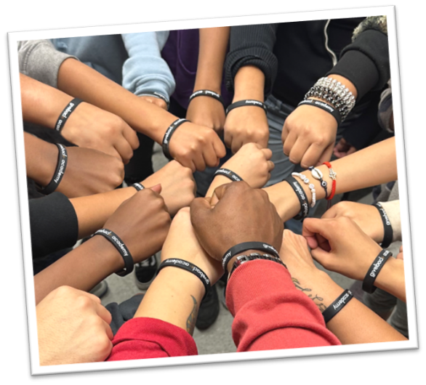
Give Back helps students who face significant financial challenges and those who have experienced barriers to success such as foster care, homelessness, or the incarceration of a parent. The program empowers students to build resilience, overcome adversity, and find pathways to become self-reliant adults and leaders of their communities.

Slide 33


Slide 34

Strategies to Address the Economic Needs and Non-Clinical Factors of Health of Survivors

Slide 35
Survivor Reported Needs of Survivors at Exit
Top 10 Reported Needs at Exit (N = 457) | Need Reported
Accessing behavioral/mental health services with providers that understand my situation | 75%
Finding people I trust that care about me and could help me | 73%
Finding a safe place to stay | 70%
Getting a stable, living-wage job | 69%
Getting a job that is a good fit for me | 68%
Accessing a healthy, supportive community | 66%
Accessing quality, healing-centered medical services | 65%
Repairing relationships with safe friends or family members | 62%
Dealing with others who shamed me for being exploited or abused | 60%
Getting an education or job training | 60%
Source: Polaris Project. In Harm’s Way: How Systems Fail Human Trafficking Survivors. Survey Results from the First National Survivor Study, January 2023.

Slide 36
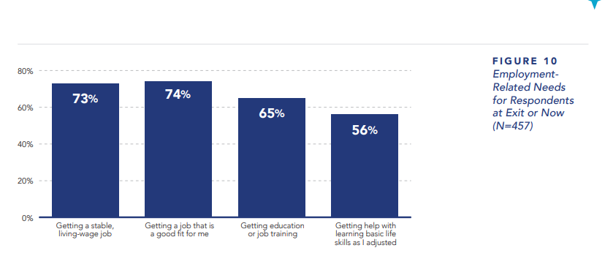
Employment Related Needs of Survivors
Source: Polaris Project. In Harm’s Way: How Systems Fail Human Trafficking Survivors. Survey Results from the First National Survivor Study, January 2023.

Slide 37
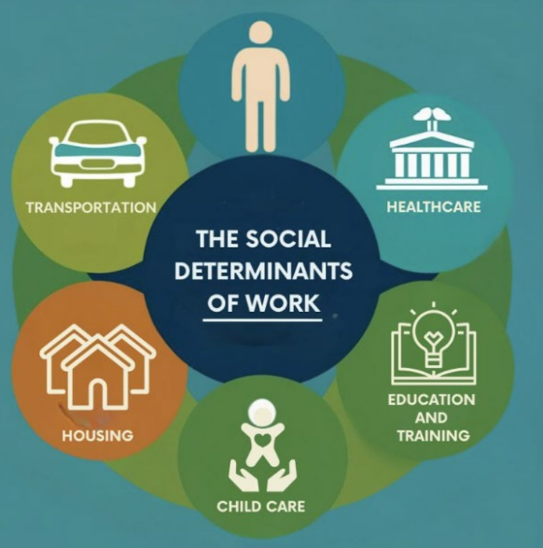
Long Term Needs for Survivors
Behavioral and mental health services
Quality healing-centered medical services
Access to alternative therapies
Managing chronic or long-lasting health issues
Paying off debt
Getting a job that fits
Healthy supportive community

Slide 38

Q & A
Please use the Zoom Q&A feature

Slide 39
Evaluation Zoom Poll
Please fill out the evaluation poll in the pop-up window.

Slide 40

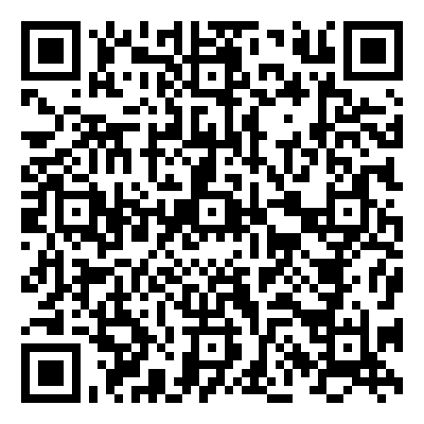
Join us forthis free upcoming webinar, register below
https://healthpartnersipve.org/learning-opp/intimate-partner-violence-and-elder-abuse-later-in-life-webinar/

Slide 41

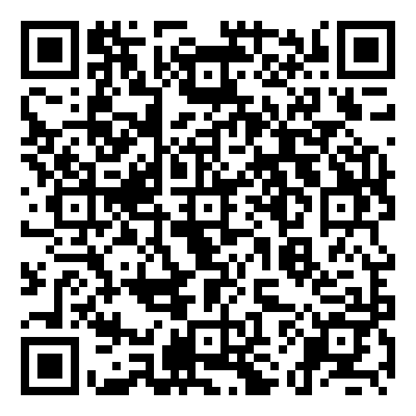
Join us for this free upcoming webinar, register below
https://healthpartnersipve.org/learning-opp/prevention-as-safety-planning-addressing-the-intersections-of-hiv-and-ipv/

Slide 42



THANK YOU!
Join Futures Without Violence’s newsletter!
https://futureswithoutviolence.org/form-page/?input_4=
This online training is supported by the Health Resources and Services Administration (HRSA) of the U.S. Department of Health and Human Services (HHS) as part of an award totaling $650,000 with 0% financed with non-governmental sources. The contents are those of the author(s) and do not necessarily represent the official views of, nor an endorsement, by HRSA, HHS, or the U.S. Government. For more information, please visit https://www.hrsa.gov/

