Slide 1



Economic and Health Needs of Survivors of
Human Trafficking
Thursday, January 29, 2026
Spanish and ASL interpretation available.
Interpretación en español y ASL disponible.
Notes:
Jake open and include instructions on captions, 1 min 11:02-03

Slide 2


How To Access Language Interpretation on Zoom
Cómo Activar la Interpretación
de Idiomas en Zoom
Notes:
Linguaficient

Slide 3


On your computer, find the Interpretation Globe Icon at the bottom of your screen
En su computadora, busque el globo terráqueo que dice Interpretación en la parte inferior de su pantalla.
Notes:
Linguaficient (1min)

Slide 4
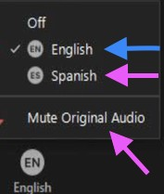
Choose English as your language. Make sure to NOT mute original audio so that you can hear the main room
Seleccione Español. Asegúrese de Silenciar Audio Original, si solo desea escuchar al intérprete
Notes:
Linguaficient (1min)

Slide 5
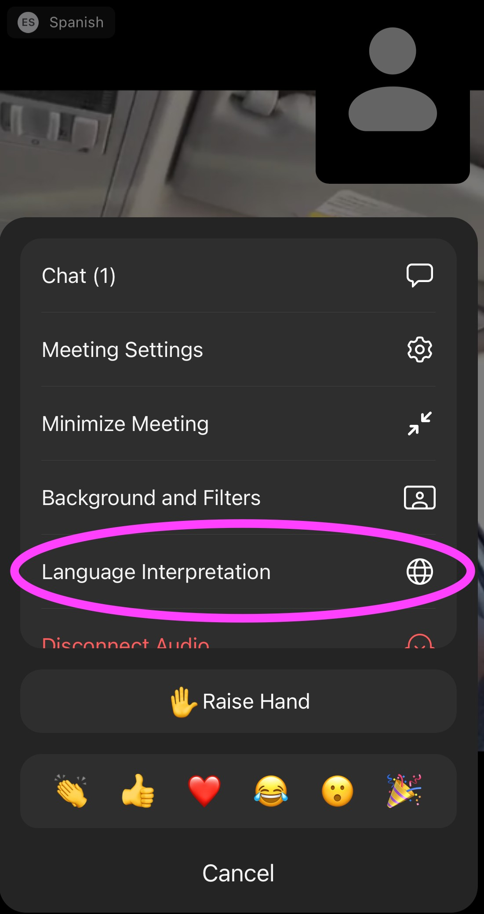
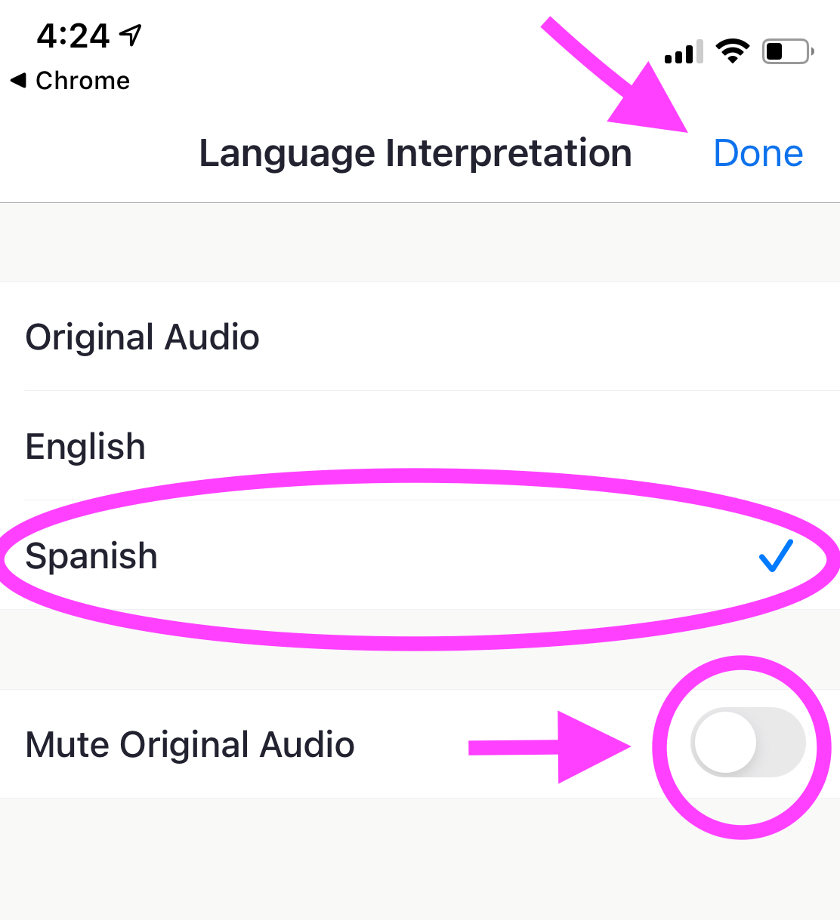
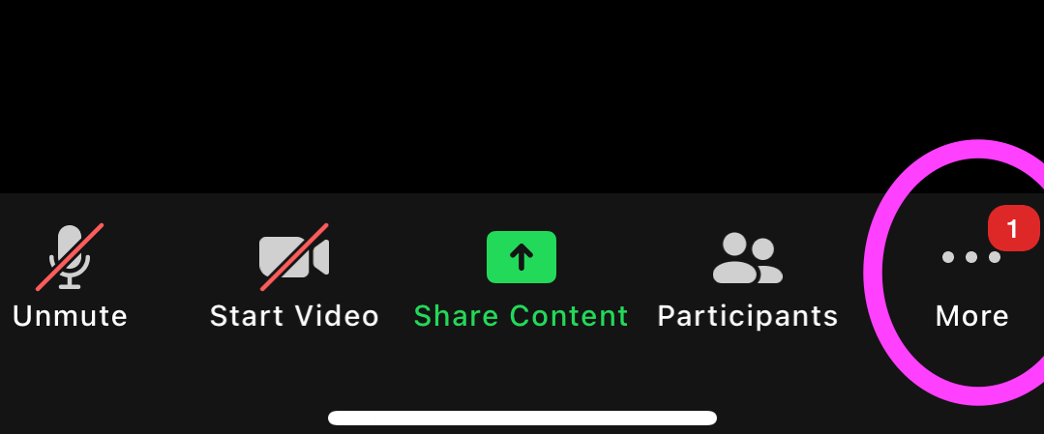
If you are on a smart device, look for the three dot menu and choose Language Interpretation.​
Then, select English.
Interpretation is not available from a Chromebook or if you dial into Zoom.
Desde un dispositivo inteligente, busque el menú de tres puntos y elija Interpretación. Después, escoja “Español” y silencie el audio original.​
No podrá acceder a la interpretación a través de un Chromebook o si marca por teléfono a la reunión de Zoom.
Notes:
Linguaficient (1min)

Slide 6





Faculty & Speakers
Anna Marjavi
Director
Health Partners on IPV+E
Futures Without Violence
Jake Sese, MPH
Program Associate
Health Partners on IPV+E
Futures Without Violence
Carolyne Ouya
Program Manager
Workplace &
Economic Opportunity
Futures Without Violence
Kimberly Chang, MD, MPH
Family Physician and Consultant
Asian Health Services
Health Partners on IPV+E
Futures Without Violence
Amy Young-Snodgrass, MD, FAAP
Chief, Forensics
Loma Linda University Children’s Hospital
Notes:
OTIP: Check out the OTIP toolkit

Slide 7

Health Partners on IPV + Exploitation
Led by Futures Without Violence (FUTURES) and funded by HRSA’s Bureau of Primary Health Care to provide technical assistance to health centers to develop and implement evidence-based strategies, protocols, and partnerships to prevent, identify, and respond to intimate partner violence and human trafficking.
We offer health center staff ongoing educational programs including:
Communities of practice on key topics for small cohorts
Live webinars + an archive
Clinical and patient tools, including for electronic health records (EHRs)
Evidence-based approaches including our CUES Intervention
Learn more: www.healthpartnersipve.org
Notes:
Jake

Slide 8
Workplace & Economic Opportunity Team
We work to ensure women, families, and all people can pursue economic choice, dignified employment and freedom from violence.
Key Initiatives:
Workplace Responds National Resource Center
Advancing Safety Through Employment Rights
Pathways to Opportunity Regional Economic Mobility Hubs
Learn more: workplacesrespond.org
Notes:
Carolyne

Slide 9
Agenda
Level setting and definitions
  Human trafficking (HT) and exploitation (E) dynamics
  Health impacts of HT/E
Discussion Part 1
  HT/E prevention and precursors to employment/economic stability
Discussion Part 2
  Needs of HT/E survivors
  Specific strategies for survivor employment support
Notes:
Learning Objectives:
As a result of this training, participants will be able to:
Describe the economic and employment needs of trafficking survivors and their connection to safety and security.
Identify two strategies that health centers can implement to create employment pathways for survivors.
Define the mental health needs of trafficking survivors and how health centers and their partners can address them.

Slide 10
Learning Objectives
At the end of this webinar, attendees will be able to:
Describe the economic and employment needs of human trafficking survivors and their connection to safety and security.
Identify two strategies that health centers can implement to create employment pathways for survivors.
Define the mental health needs of human trafficking survivors and how health centers and their partners can address them.
Notes:
Kim, 1 min
✔ Scope of healthcare professionals is to provide patient care and support, including chronic disease management, not to investigate or determine whether a patient is a crime victim.
✔ The term exploitation is expansive, addresses vulnerabilities, and includes avenues for prevention.
✔ Any commercial sex act of a child/adolescent is child abuse. All mandatory reporting laws should be followed.
✔ Many survivors of trafficking may not identify as such, or know the legal terms or definitions.
✔ Many survivors of trafficking may not identify as such, or know the legal terms or definitions.
The scope of healthcare professionals is to provider support, not to investigate or determine whether or not the circumstances meet the criminal definition of trafficking.
Exploitation is more expansive, addresses vulnerabilities, and includes avenues for prevention.
Health providers address the broad spectrum of exploitation, abuse, and harm; from prevention to intervention to chronic disease management; and social risk factors around health.
Any commercial sex act of a child/adolescent is child abuse. All mandatory reporting laws should be followed.
Many survivors of trafficking may not identify as such, or know the legal terms or definitions
Note to Trainer: Read this slide aloud.
•United States, Department of State, Office to Monitor and Combat Trafficking. (n.d.). Trafficking in Persons Report 2013.
•U.S. DHHS report: Human Trafficking into and Within the United States: A Review of the Literature 8/30/2009, Office of the Assistant Secretary for Planning and Evaluation, U.S. Department of State.
•National Alliance to End Homelessness, Issue Brief: Commercial Sexual Exploitation of Children (CESC) and Youth Homelessness. 2015. https://www.1800runaway.org/wp-content/uploads/2015/05/National-Alliance-to-End-Homelessness-issue-brief.pdf
•The statistics from the National Human Trafficking Hotline are based on the signals -- phone calls, emails, and webforms -- received by the NHTH that reference North Carolina. https://humantraffickinghotline.org/state/north-Carolina
Background Info:
Given the correlations between runaway/throwaway youth and minors exploited through prostitution (Estes & Weiner, 2001), findings from the Second National Incidence Studies of Missing, Abducted, Runaway, and Thrown away Children can offer additional information about the possible prevalence of minors trafficked or at risk of being trafficked domestically into the commercial sex industry (Hammer, Finkelhor, & Sedlak, 2002). For example, in 1999, 1,682,900 youth had a period of time in which they could be characterized as a runaway or throwaway youth; 71 percent of these youth were considered at risk for prostitution (Estes & Weiner, 2001).
Data reported by the runaway and homeless youth programs supported by funding from the Family and Youth Services Bureau (FYSB) within HHS provide additional information about this at-risk youth population. In 2007, 50,718 youth received services from FYSB-funded runaway and homeless programs (U.S. Department of Health and Human Services, n.d.). Of these youth, 54 percent were female. Additionally, 770,223contacts (distribution of written materials, health and hygiene products, and/or food and drinks) were made with youth through street outreach programs. It is unclear, however, whether these numbers include duplicate counts (e.g., youth receiving services multiple times from one or more service providers), which is a problem often inherent in administrative data (Gozdziak & Collett, 2005). In addition, it is not known how many street youth do not come into contact with service providers.
National juvenile arrest data provide another glimpse of the potential magnitude of the domestic trafficking of youth. Nationwide in 2003, 2,220,300 juveniles were arrested, 11 percent fewer than in 1999 (U.S. Department of Justice, 2004). During 2003, 1,400 youth were arrested for prostitution and commercialized vice. Of these youth, 69 percent were female and 14 percent were younger than age 15. Unlike overall juvenile arrest rates, these numbers increased 31 percent between 1994 and 2003.
Notwithstanding these general data, there is no clear consensus on the numbers of girls versus boys exploited through prostitution nationwide. The differential treatment of boys and girls, coupled with the differences in the circumstances under which they prostitute (including location), make these statistics extremely difficult to interpret.
As with most other data related to human trafficking, there are huge gaps between estimates of prevalence or populations at risk and individuals actually identified as trafficking victims or enrolled in government programs. Better data and analysis of the studies are needed to begin distinguishing among possible reasons for the gaps between prevalence estimates and administrative data.
In addition to domestic sex trafficking, American minors and adults are likely trafficked for forced labor; however, children are generally preferred to adults in the labor world as they are more easily controlled, cheaper, and less likely to demand better working conditions (Herzfeld, 2002). Unfortunately, we know even less about labor trafficking, both into and within the United States, than we do about sex trafficking. There is evidence that forced child labor exists in the African and Latin American regions and also in more developed countries such as the United States (International Labor Organization, 2002). An International Labor Organization study indicated that girls are more likely to be trafficked for commercial sexual exploitation and domestic services, and boys tend to be trafficked for forced labor in commercial farming, petty crimes, and the drug trade.
A review of the data on child labor, however, provides some insight into the potential for labor trafficking within the United States. Data from the National Longitudinal Survey of Youth 1997 (NLSY97) show substantial work activity among 14- and 15-year-old children (Bureau of Labor Statistics, 2001). Employment among 14- and 15-year olds was concentrated in a small number of industries, with restaurants and supermarkets the most common industries in which youth were employed. Babysitting and yard work were by far the most common freelance jobs youth reported having worked. NLSY97 figures and those of the Child Labor Coalition (CLC) indicate that youth employment is growing in the United States. The CLC estimated there are 5.5 million youth between the ages of 12 and 17 employed across the United States. This estimate was derived from the NLSY97 data. The CLC (2007) also estimates there are 500,000 U.S. children working in various agricultural settings, with most being members of minority groups. In addition to agricultural work, the CLC estimates 50,000 children are involved in street peddling, including peddling magazines, candy, and other consumer goods. Many teens become involved, believing peddling is a good way to make money, and do not realize the dangers associated with these activities. The CLC indicates that youth peddlers work long hours with little pay, in extreme temperatures, and with no access to bathrooms, water, or food; work for activities or prizes they never receive; and work alone in strange neighborhoods or cities. Youth peddlers also may be abandoned or deserted if they do not meet their quota for the day, or may be forced to walk home for angering the crew leader. Many parents are also unaware of these dangers and believe they are allowing their children to work for respected and legitimate companies.
In FY 2004, the U.S. Department of Labor found 1,087 minors employed in violation of Hazardous Occupation Standards.
•National Trafficking Hotline 2016 Report https://humantraffickinghotline.org/states
•Lederer L., & Wetzel, C.A. (2014). The health consequences of sex trafficking and their implications for identifying victims in facilities. The Annals of Health Law, 23(1): 16–91.
•Covenant House. Homelessness, Survival Sex and Human Trafficking: As Experienced by the Youth of Covenant House New York. May 2013

Slide 11

Human Trafficking and Exploitation: Definitions and Dynamics
A Case Study
“He said that he would fire me, my husband, my brother-in-law, and all the employees at the restaurant!”
Notes:
Kim, animation with 2 clicks
11:10 - 11:30 (20 minutes total for slides 9 - 21)
Notes to Trainer: Let’s start with a case study of how a patient might present to the health center.
OT was a refugee woman in her first pregnancy, who worked at a local restaurant. She came to the health center for severe morning sickness, unable to hold down any oral intake, and requiring intravenous fluids. Due to her illness, she requests a doctors note to excuse her from work because of the recurrent dehydration, nausea, and vomiting. After giving the excuse note to her employer, however, she comes back the next week, stating that her boss fired her because she is unable to work. Knowing that pregnancy related illnesses are considered disabilities protected under employment law, the doctor provides another note to the employer stating that patient cannot be fired for pregnancy related illnesses. The following week, the patient returns visibly distraught, and says that her employer is very angry about the second note, and has now threatened to fire the patient, her husband, her brother-in-law, and all of the workers from her same refugee group!
Is this human trafficking? How would/should the provider respond?
In this case, the provider recognized the employment violations, connected the patient with the health center’s case management and integrated behavioral health department, which then contacted local legal aid services. Ultimately the patient’s employment was restored, with this case serving as an example for several wage and labor violations for which the restaurant owners were fined several years later.
This in an individual case of a patient at risk for human trafficking who encountered the health center, but what do we know about the broader general interactions with health care by those at risk of or affected by human trafficking? Let’s look at some of the analysis.

Slide 12
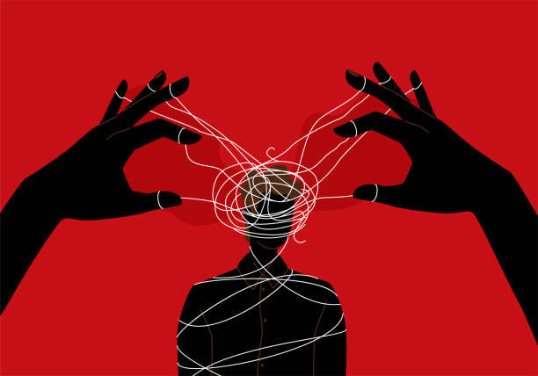
Underlying Dynamics of Human Trafficking and Exploitation
Power and Control
With a Profit Motive
Notes:
Kim, 1 min
Before we get into the legislative definitions and the details of human trafficking and exploitation, understand that it is really a dynamic of power and control for a profit motive. Denial of shared humanity to make money off of the labor or bodies of someone else, through certain tactics. It can be individually mediated by one person, or it can be systematic (with organized supply chains). You must also understand that the underlying dynamic is the same as it is with Intimate partner violence - power and control.

Slide 13
Labor Exploitation, Labor Violations, Labor Trafficking:
A Spectrum of Experiences
Labor exploitation: an employer unfairly benefits from employee’s work. Labor exploitation is not a legal term—in fact, not all forms of labor exploitation are illegal.
Labor Exploitation
Labor Violations
Labor violations: a legal term used when employers violate federal, state, or municipal laws related to worker treatment, workplace safety, or recordkeeping requirements.
Labor Trafficking
Notes:
Kim, 1 min
A public health approach to human trafficking focuses on identifying and addressing the root causes of vulnerability to trafficking

Slide 14
Sexual Violence, Sexual Exploitation, Sex Trafficking: A Spectrum of Experiences
Sexual Violence: includes rape, sexual assault, sexual harassment, nonconsensual image sharing, incest, child sexual assault, public masturbation, watching someone engage in private acts without their consent, unwanted sexual contact/touching.
Sexual Violence
Sexual Exploitation
Sexual Exploitation: Actual or attempted abuse of a position of vulnerability, power, or trust, for sexual purposes, including, but not limited to, profiting monetarily, socially or politically from the sexual exchanges:
Coercion from employers/workplace
Coercive rent/debt exchange
Trading drugs
Sex Trafficking
Notes:
Kim, 1 min

Slide 15
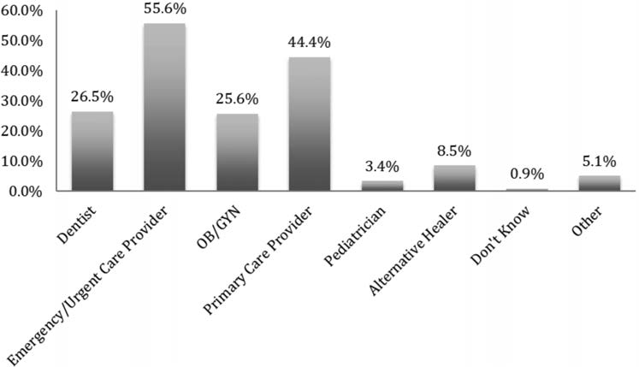
Survivor Interactions with Healthcare
Victims encounter a variety of health care professionals while being trafficked.
Percentage of victims* who came in contact with health care professionals (by specialty)
While being trafficked:
87.8% of trafficked victims encountered a health care provider and 57.1% visited a clinic
None were identified as being trafficked.
(Lederer et al. 2014)
(Chisolm-Straker et al. 2016)
*Some patients had received services from multiple categories of providers
Notes:
Kim, 1 min
Notes to Trainer: The literature shows that health care professionals can help care for victims of human trafficking.
One study of survivors showed that, while being trafficked, almost 88% had encountered any type of health care provider, and 57% had visited a clinic. None were identified as being trafficked.
And what kind of health care professionals do survivors see when seeking care? Another study of survivors shows the types of care providers seen by specialty. Community health centers provide care in all of these specialties, with urgent care being a proxy for emergency care.
It is clear that health care has an important role in addressing human trafficking and exploitation. As we go through this section, we will discuss definitions of human trafficking and the broader public health definition of exploitation, some dynamics of trafficking, what populations are at increased risk, the role of health care, and reflect on the intersectionality with intimate partner violence. At the end of this section you will understand why health centers are critical partners in preventing exploitation and caring for those who have experienced trafficking.
Image source:
Chisolm-Straker M, Baldwin S, Gaïgbé-Togbé B, Ndukwe N, Johnson PN, Richardson LD. Health Care and Human Trafficking: We are Seeing the Unseen. Journal of Health Care for the Poor and Underserved. August 2016; 27(3)1220-1233.

Slide 16
Health Issues that Lead to Encounters with Healthcare for HT Victims/Survivors
Emergent Medical Conditions
  Profuse bleeding or pain caused by a beating or forced termination, injury on a job site, or complications during pregnancy, such as an ectopic pregnancy
  Severe wound infections with signs of septicemia
Gynecological Services
  For sexually transmitted infections
Late or No Prenatal Care
(Toney-Butler TJ, et al. 2023)
Notes:
Erica, 2 minutes
Toney-Butler TJ, Ladd M, Mittel O. Human Trafficking. [Updated 2023 Jun 11]. In: StatPearls [Internet]. Treasure Island (FL): StatPearls Publishing; 2025 Jan-. Available from: https://www.ncbi.nlm.nih.gov/books/NBK430910/

Slide 17
Health Issues that Lead to Encounters with Healthcare for HT Victims/Survivors Continued
Substance use and addiction issues
  Such as a severe overdose or withdrawal signs and symptoms
Mental health problems
  Depression, suicide attempts, or anxiety disorder
Somatizing of mental distress
  Headaches, stomach aches, fatigue, dizziness
Dental emergencies
Musculoskeletal injuries
Plastic surgery consultations
(Toney-Butler TJ, et al. 2023)
Notes:
Erica, 2 minutes
Toney-Butler TJ, Ladd M, Mittel O. Human Trafficking. [Updated 2023 Jun 11]. In: StatPearls [Internet]. Treasure Island (FL): StatPearls Publishing; 2025 Jan-. Available from: https://www.ncbi.nlm.nih.gov/books/NBK430910/
Oral health resources, put in chat @ Jake

Slide 18


HT and Behavioral Health
Anxiety and/or depression
Panic disorder
Post-traumatic stress disorder (PTSD)
Antisocial behavior
Suicidal behavior
Sleep disturbances
Substance use disorders
Eating disorders
(Conley, et al. 2023)
(Mazeda, et al. 2010)
(Zimmerman, et al. 2011)
Notes:
Erica, 1 min
Notes to Trainer: Share with the audience “As with physical health, experiencing trafficking can have a significant negative impact on mental health and substance use coercion. Some of the patients that we consider the most “difficult” or non-compliant may also be experiencing violence or trafficking.”
Sources:
Abigail H. Conley, Kellie E. Carlyle, Gary Cuddeback, Susan G. Kornstein, Working with Survivors of Sex Trafficking: Mental Health Implications, Psychiatric Clinics of North America, Volume 46, Issue 3,2023.
Mazeda Hossain MSc, Cathy Zimmerman PhD, Melanie Abas MD, MSc, Miriam Light MSc, and Charlotte Watts PhD, The Relationship of Trauma to Mental Disorders Among Trafficked and Sexually Exploited Girls and Women, American Journal of Public Health (AJPH) December 2010
Cathy Zimmerman, Mazeda Hossain, Charlotte Watts. Human trafficking and health: A conceptual model to inform policy, intervention and research, Social Science & Medicine, July 2011

Slide 19

Intersection of Health and Economic Security
Common Challenges:
Suffer workplace injuries due to unsafe conditions
Cognitive and physical disabilities that may require workplace accommodations
Co-occurring mental health disorders
Education and work history gaps
Struggling to meet basic needs
Increased vulnerability to exploitation
Notes:
Use this slide to tell story of Bay Area labor trafficking survivor with PTSD and physical disability who struggled to find work due to gaps in work history and need for accommodations. Lack of work impacted housing and access to basic needs. (46% reported making under $25,000- Polaris)

Slide 20


Exploring Health System Strategies for Prevention and Intervention of Exploitation

Slide 21
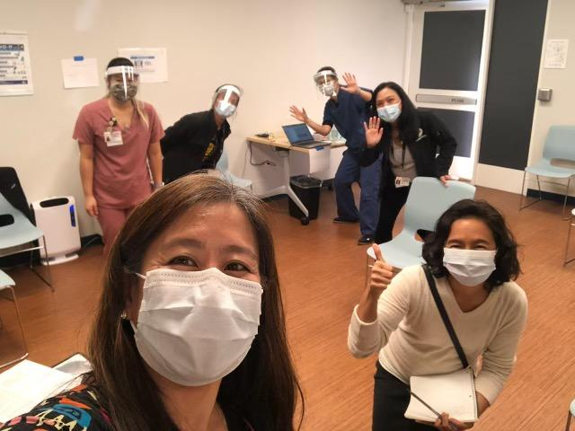
Overview of Health Centers (HCs)
Health centers are community-based and patient-directed organizations that deliver no-cost/low-cost comprehensive primary health care.
They often include:
Pharmacy
Mental health services
Substance abuse programs
Oral health services
Photo: CHC Staff at Asian Health Services in Oakland, CA in 2021
Located in medically underserved areas and for medically underserved populations.
Find a health center here: https://findahealthcenter.hrsa.gov/
Notes:
Jake, 1-2 minutes
Health centers are community-based and patient-directed organizations that deliver comprehensive, high-quality primary health care services.
Health centers also often integrate access to pharmacy, mental health, substance abuse, and oral health services in areas where economic, or geographic barriers limit access to affordable health care services.
They provide services regardless of patients’ ability to pay and charge for services on a sliding fee scale.
They also offer transportation to the clinic and language services
According to the most recent Health Center Patient Survey, 97% of patients would recommend their health center to family or friends.

Slide 22


RICA
11374 Mountain View Ave.
Loma Linda, CA 92354

Slide 23
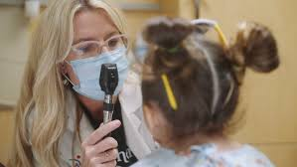
Forensic Pediatrics
Expertise in biomechanics and mechanism of injury
Perform evaluations, diagnosis, treatment and management of cases of child abuse and neglect
Head trauma, organ injury/abdominal injury, fractures, burns, cutaneous injuries, sexual abuse/exploitation, severe neglect, intentional poisonings, child torture, medical child abuse
Three-year fellowship training, board certification in Pediatrics and Child Abuse Pediatrics
Workforce shortage
Expertise in patient-directed care
Provide expert medical testimony

Slide 24
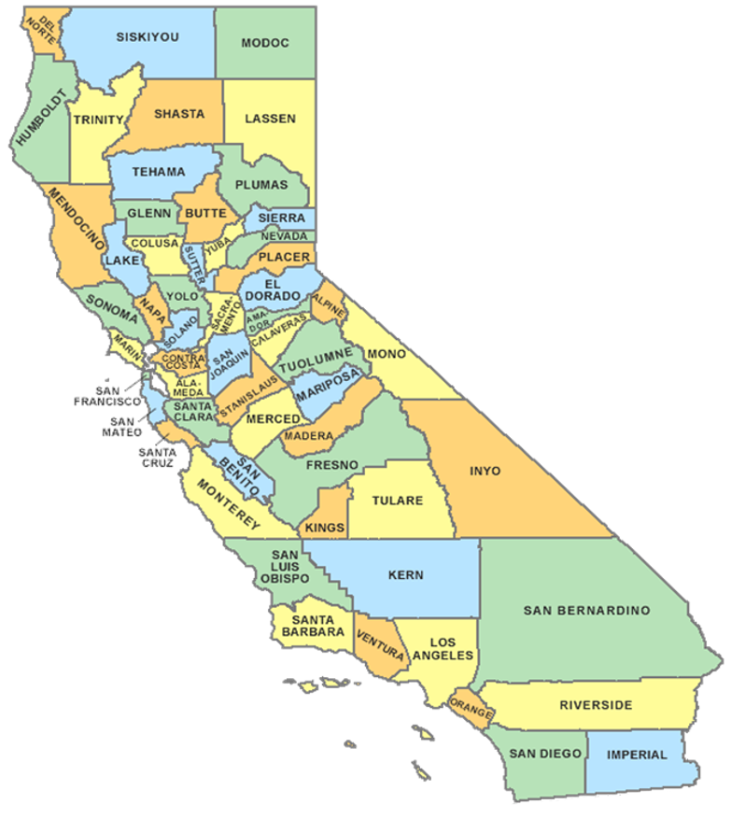
The Loma Linda team covers the largest geographic region in the county
Over 4,000 cases each year
Roughly 25 homicides

Slide 25
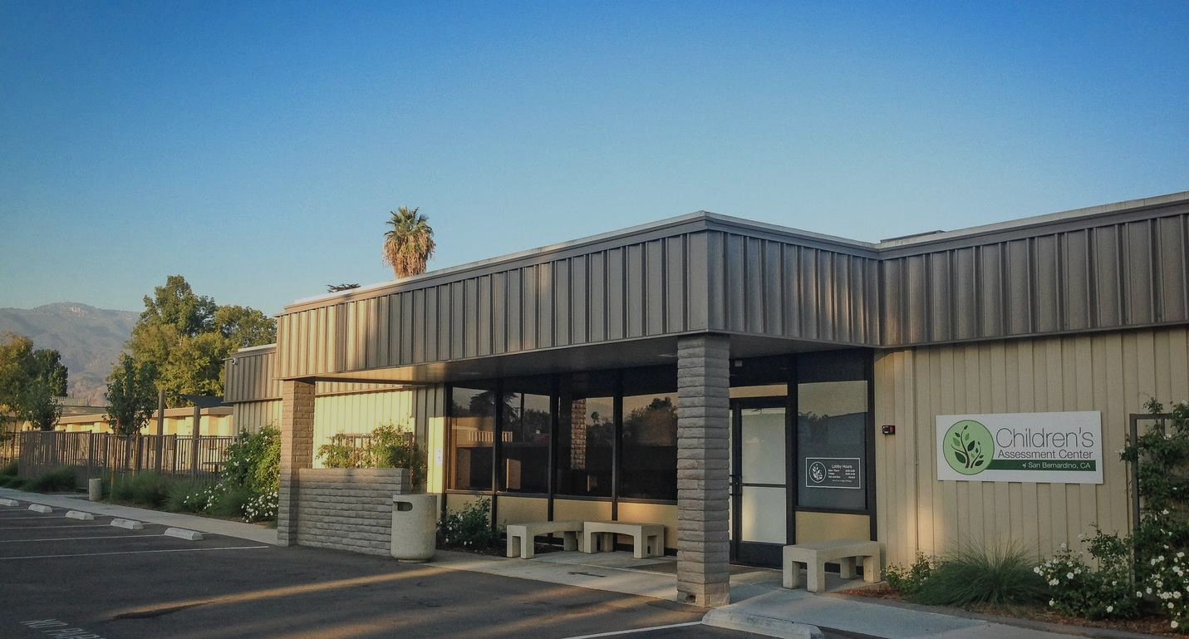
What is the Children’s Assessment Center?
The Children's Assessment Center of San Bernardino is a public and private partnership between San Bernardino County and Loma Linda University Children's Hospital, providing forensic interviews and evidentiary medical examinations to assist in the evaluation of child abuse allegations. The CAC coordinates services in a child-focused atmosphere, thus reducing harm to child victims and their families.

Slide 26

Services
CAC offers multidisciplinary services for suspected child abuse victims including:
Forensic Interviews
Outpatient Forensic Medical Exams
Follow-up for Inpatient Cases
Victim Advocacy
Mental Health Assessments and Referrals

Slide 27

Partnerships
Loma Linda University Children’s Hospital
County of San Bernardino
  Department of Behavioral Health
  Children & Family Services
  District Attorney’s Office
  Sheriff’s Department
  Children’s Network
  First 5
Children’s Fund
Local Police Departments

Slide 28
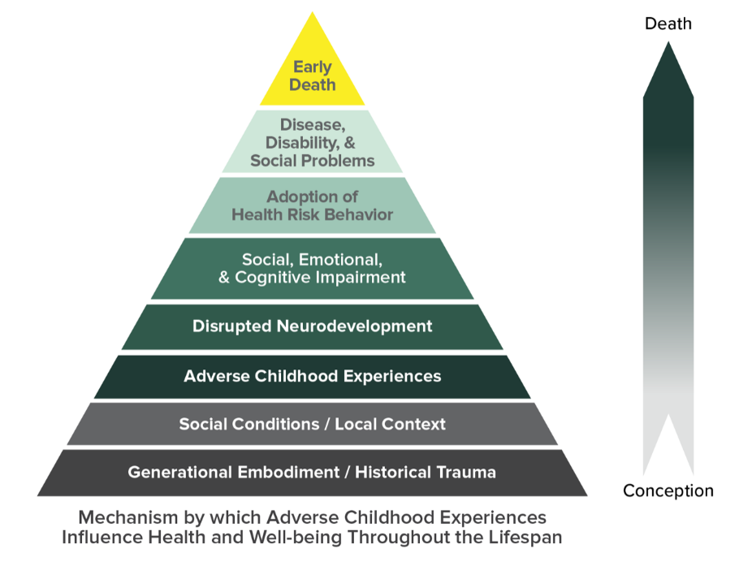
Adverse Childhood Experiences
Physical Abuse
Sexual Abuse
Emotional Abuse
Emotional Neglect
Physical Neglect
Parental Separation/Divorce
Exposure to Violence in the Home
Caregiver with Substance Abuse
Caregiver with Mental Health Concerns
Incarcerated Caregiver

Slide 29
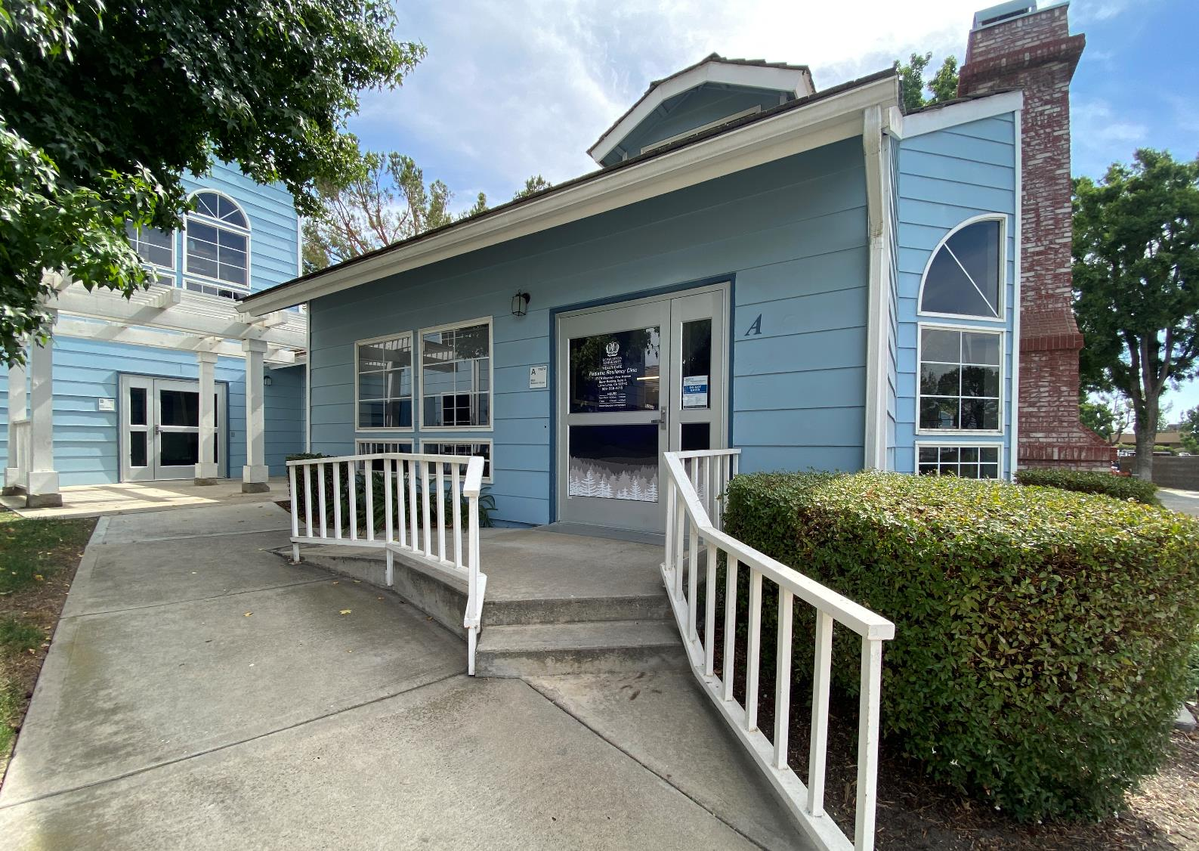
Resiliency Institute for Childhood Adversity (RICA)
Integrated Clinical Services
Interdisciplinary Education
Research

Slide 30
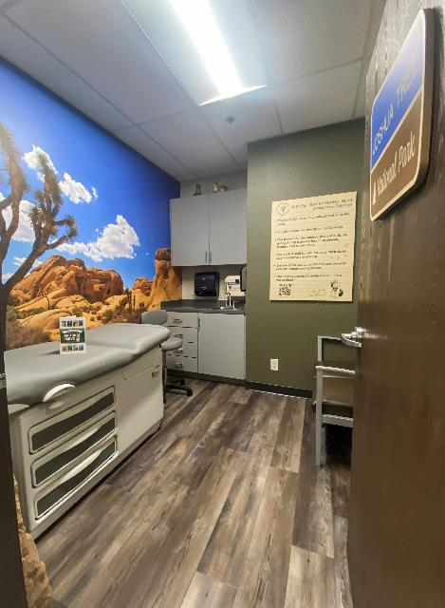

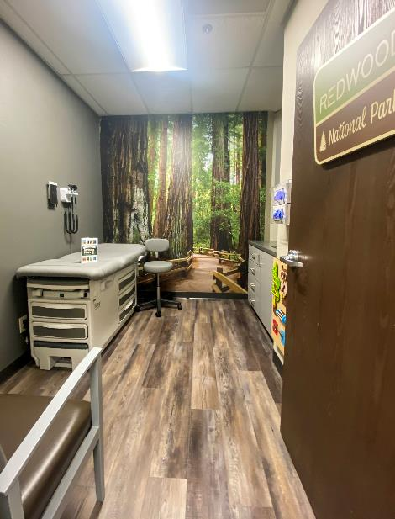


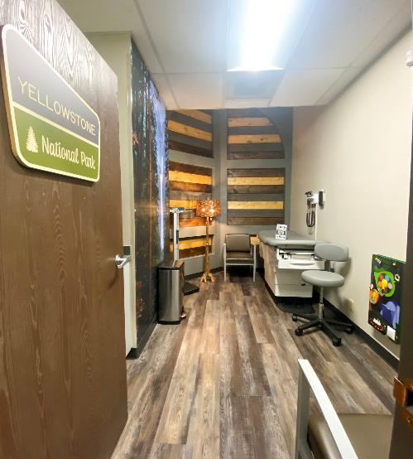
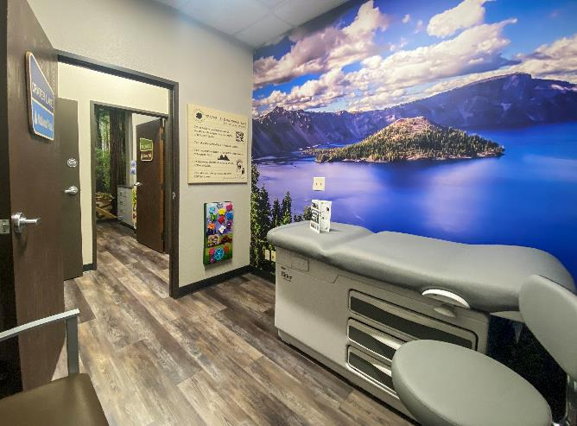



EXAM
ROOMS

Slide 31

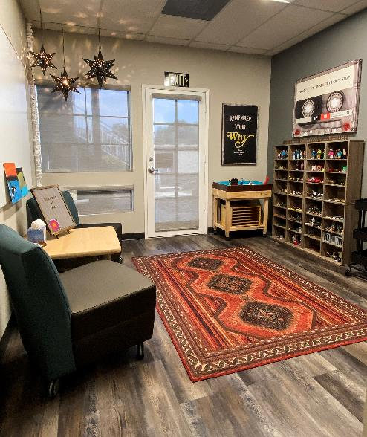


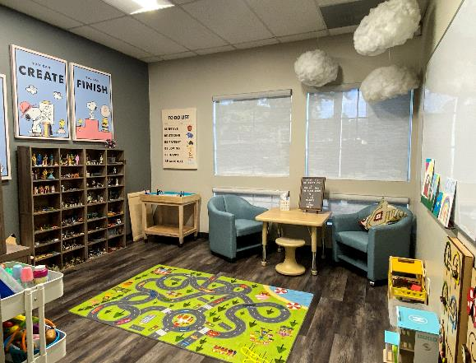
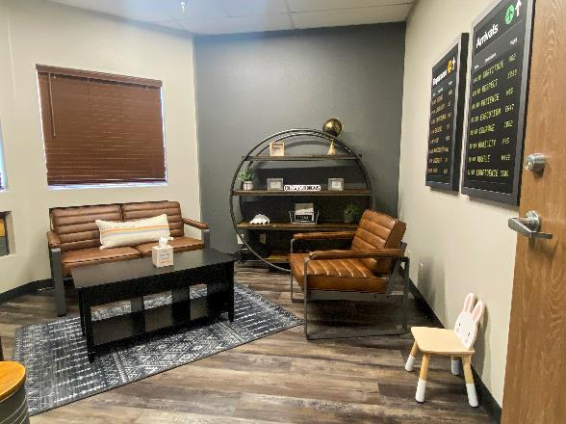

LOBBY
THERAPY ROOM
THERAPY ROOM
FAMILY THERAPY

Slide 32

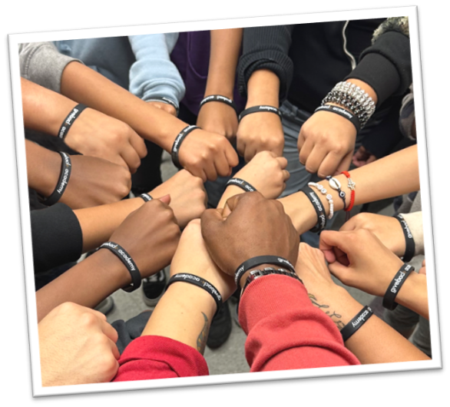
Give Back helps students who face significant financial challenges and those who have experienced barriers to success such as foster care, homelessness, or the incarceration of a parent. The program empowers students to build resilience, overcome adversity, and find pathways to become self-reliant adults and leaders of their communities.

Slide 33


Slide 34

Strategies to Address the Economic Needs and Non-Clinical Factors of Health of Survivors

Slide 35
Survivor Reported Needs of Survivors at Exit
Top 10 Reported Needs at Exit (N = 457) | Need Reported
Accessing behavioral/mental health services with providers that understand my situation | 75%
Finding people I trust that care about me and could help me | 73%
Finding a safe place to stay | 70%
Getting a stable, living-wage job | 69%
Getting a job that is a good fit for me | 68%
Accessing a healthy, supportive community | 66%
Accessing quality, healing-centered medical services | 65%
Repairing relationships with safe friends or family members | 62%
Dealing with others who shamed me for being exploited or abused | 60%
Getting an education or job training | 60%
Source: Polaris Project. In Harm’s Way: How Systems Fail Human Trafficking Survivors. Survey Results from the First National Survivor Study, January 2023.

Slide 36
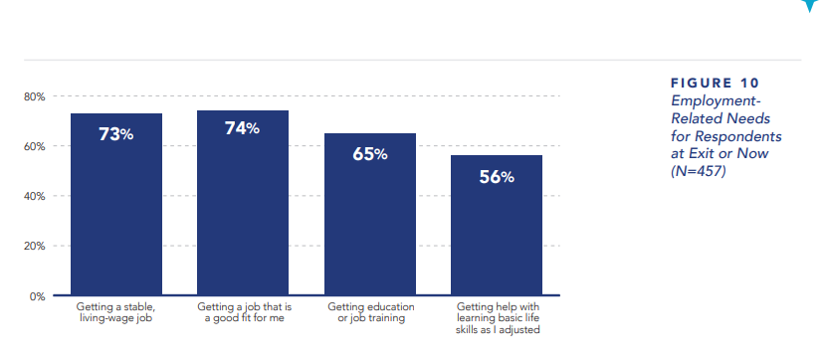
Employment Related Needs of Survivors
Source: Polaris Project. In Harm’s Way: How Systems Fail Human Trafficking Survivors. Survey Results from the First National Survivor Study, January 2023.

Slide 37
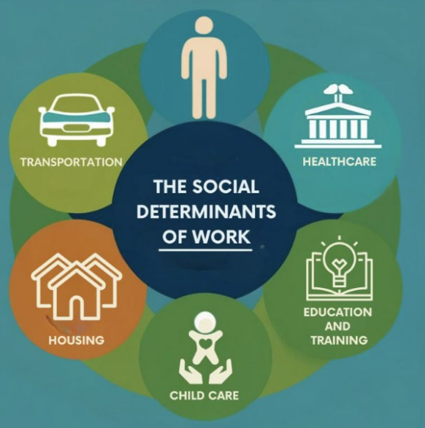
Long Term Needs for Survivors
Behavioral and mental health services
Quality healing-centered medical services
Access to alternative therapies
Managing chronic or long-lasting health issues
Paying off debt
Getting a job that fits
Healthy supportive community

Slide 38

Q & A
Please use the Zoom Q&A feature

Slide 39
Evaluation Zoom Poll
Please fill out the evaluation poll in the pop-up window.
Notes:
11:00

Slide 40
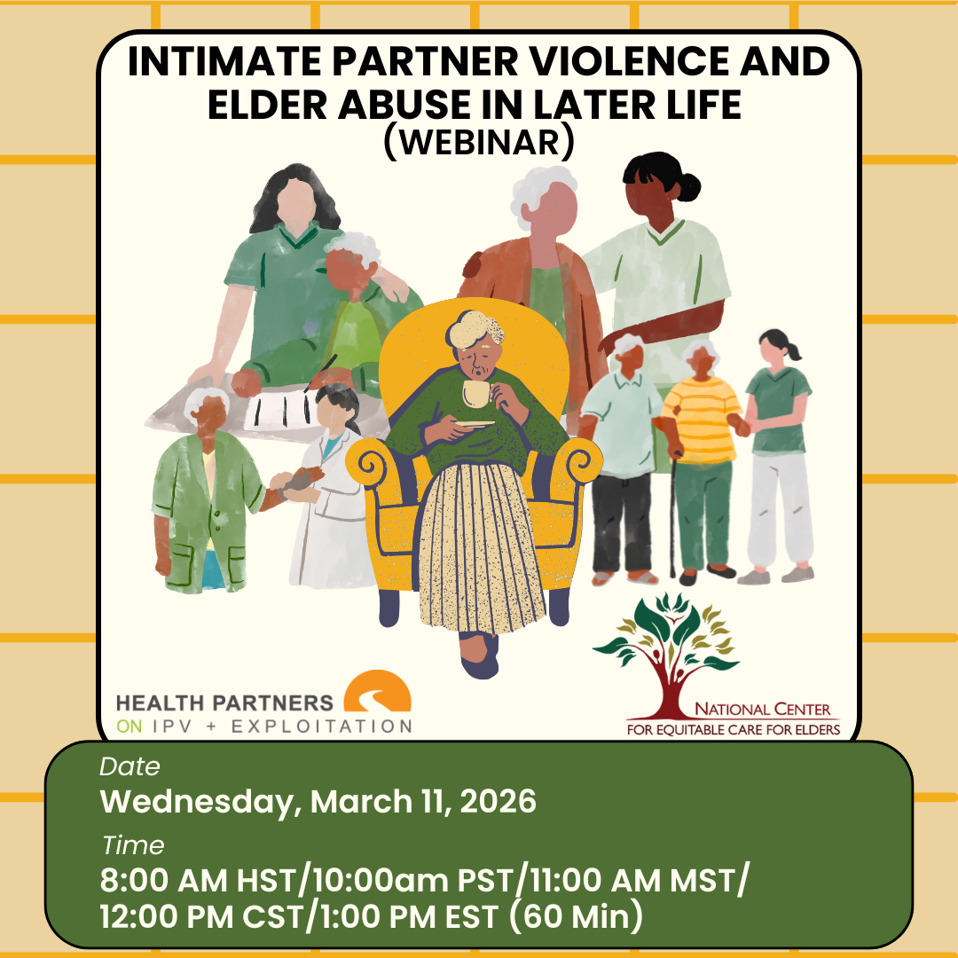

Join us forthis free upcoming webinar, register below
https://healthpartnersipve.org/learning-opp/intimate-partner-violence-and-elder-abuse-later-in-life-webinar/

Slide 41


Join us for this free upcoming webinar, register below
https://healthpartnersipve.org/learning-opp/prevention-as-safety-planning-addressing-the-intersections-of-hiv-and-ipv/

Slide 42



THANK YOU!
Join Futures Without Violence’s newsletter!
https://futureswithoutviolence.org/form-page/?input_4=
This online training is supported by the Health Resources and Services Administration (HRSA) of the U.S. Department of Health and Human Services (HHS) as part of an award totaling $650,000 with 0% financed with non-governmental sources. The contents are those of the author(s) and do not necessarily represent the official views of, nor an endorsement, by HRSA, HHS, or the U.S. Government. For more information, please visit https://www.hrsa.gov/

